Slide 1
Comparative advantage:
The Ricardian model of trade
Lecturer: Pierre-Louis Vézina
p.vezina@bham.ac.uk

Slide 2
Intro
The Ricardian model gives an explanation as to why countries would trade
It presents comparative advantage as a source of gain from trade
Countries gain from trade because they are different
But how are they different?

Slide 3
Warning
By the end of today’s lecture, you still won’t understand the concept of comparative advantage
It is simple yet not obvious, and intelligent people usually don’t get it

Slide 4
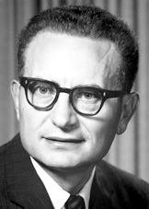
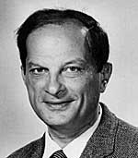
A famous anecdote
  Mathematician Stanislaw Ulam challenged Nobel Economist Paul Samuelson to ‘name me one proposition in all of the social sciences which is both true and non-trivial.’
  Samuelson came up with an answer: comparative advantage
  ‘that it is not trivial is attested by the thousands of important and intelligent men who have never been able to grasp the doctrine for themselves or to believe it after it was explained to them.’

Slide 5
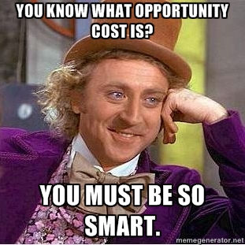
A key concept

Slide 6


Opportunity cost
David Beckham is a great lawn mower
He can mow his lawn in two hours

Slide 7
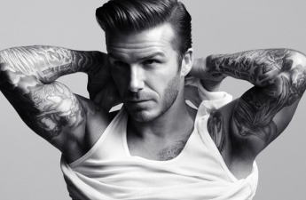
Opportunity cost
Instead of mowing his lawn, David could spend the two hours filming a commercial and make £10,000
➔ David‘s opportunity cost of mowing his lawn is £10,000
Notes:
His oc is how much money he cd make by not mowing his lawn

Slide 8

Opportunity cost
Neighbour Scotty can mow David's lawn in 4 hours.
He could also work at McDonald's for 4 hours and make £8 per hour.
➔ Scotty's opportunity cost of mowing David's lawn is £32

Slide 9
Opportunity cost
Who is better at mowing the lawn?

Slide 10
Opportunity cost
Who is better at mowing the lawn?
  David Beckham. He can do it in 2 hours rather than 4. He has an absolute advantage in mowing the lawn.

Slide 11
Opportunity cost
Who is better at mowing the lawn?
  David Beckham. He can do it in 2 hours rather than 4. He has an absolute advantage in mowing the lawn.
Who has a comparative advantage in mowing the lawn?

Slide 12
Opportunity cost
Who is better at mowing the lawn?
  David Beckham. He can do it in 2 hours rather than 4. He has an absolute advantage in mowing the lawn.
Who has a comparative advantage in mowing the lawn?
  Scotty. He can do it at a lower opportunity cost (£32 versus £10,000).

Slide 13
Opportunity cost
Gains from specialization and trade:
  If David pays Scotty about £50 (more than his McDonald’s salary) to mow his lawn, he can film his commercial.
  Both are better off than in a situation where the best lawn mower in the world, David Beckham, mowed his lawn.

Slide 14
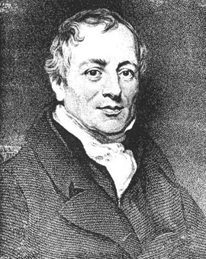
Comparative advantage
What about international trade?
David Ricardo originally proposed the concept of comparative advantage in 1817

Slide 15
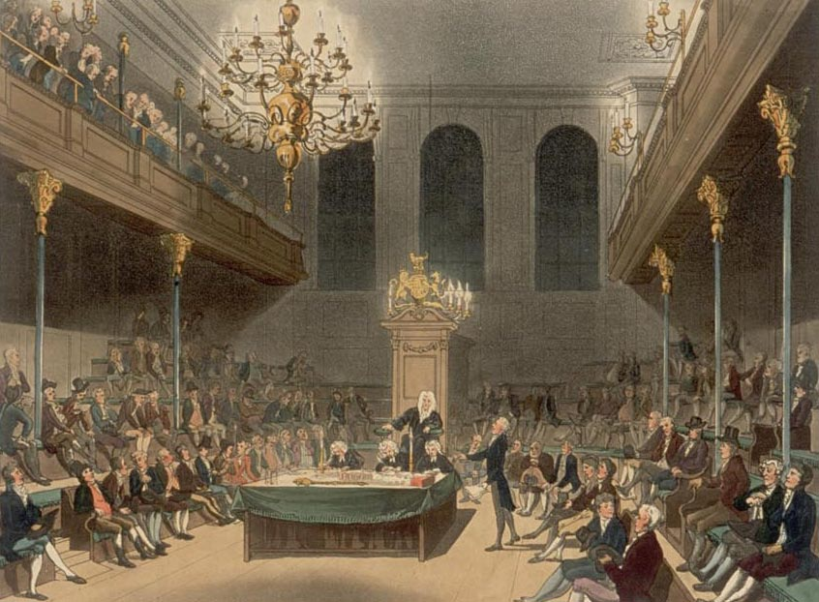
Comparative advantage
He was a financial market speculator who amassed a fortune and then bought a seat in the UK Parliament to argue against protectionism

Slide 16
Comparative advantage
He believed that the British "Corn Laws"—tariffs on agricultural products, were a terrible thing for Britain
He advocated free trade and the repeal of the Corn Laws
  (the fight against the Corn Laws also gave rise to The Economist magazine in 1843)

Slide 17
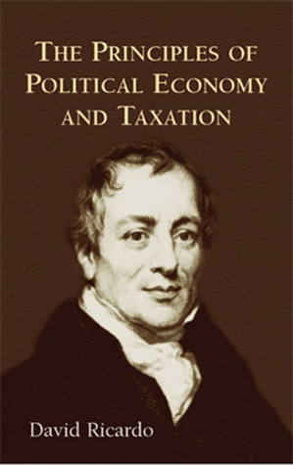
Comparative advantage
How did he make his case for free trade?
Ricardo attempted to prove, using a simple numerical example, that international trade is always beneficial
    The Ricardian model of trade

Slide 18
Comparative advantage
  The Ricardian model of trade in the words of Paul Samuelson:
    "In spite of the fact that the Portuguese could produce both cloth and wine with less amount of labor, Ricardo suggested that theoretically both countries benefit from trade with each other."

Slide 19


The Ricardian model
2 countries: UK and Portugal

Slide 20

The Ricardian model
2 countries: UK and Portugal
Labor is the only factor of production

Slide 21
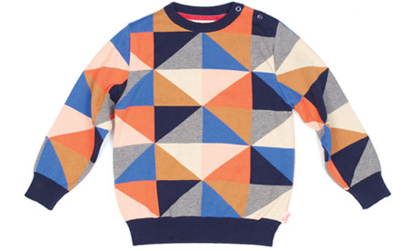

The Ricardian model
2 countries: UK and Portugal
Labour is the only factor of production
Only two goods (wine and cloth)

Slide 22
The Ricardian model
2 countries: UK and Portugal
Labor is the only factor of production
Only two goods (wine and cloth)
The only difference between the 2 countries is technology (or labour productivity)

Slide 23
The Ricardian model
Technology can be expressed in terms of
  unit labour requirement: Number of hours of labour required to produce one unit (a bottle of wine, a sweater)
  The higher the unit labour requirement, the lower the productivity

Slide 24
The Ricardian model
Unit labour requirements (hours required to produce)
 | UK | Portugal
A bottle of wine | a_{W}=3 | a_{W}*=2
A sweater | a_{c}=2 | a_{c}*=1

Slide 25
The Ricardian model
Unit labour requirements (hours required to produce)
 | UK | Portugal
A bottle of wine | a_{W}=3 | a_{W}*=2
A sweater | a_{c}=2 | a_{c}*=1
The stars (*) are for Portugal, remember that!

Slide 26
The Ricardian model
Production possibilities
  The UK can produce:
    a certain quantity of sweaters Q_{C}
    a certain quantity of bottles of wine Q_{W}

Slide 27
The Ricardian model
Production possibilities
  The UK can produce:
    a certain quantity of sweaters Q_{C}
    a certain quantity of bottles of wine Q_{W}
Q is for Quantity

Slide 28
The Ricardian model
Production possibilities
  The UK can produce:
    a certain quantity of sweaters Q_{C}
    a certain quantity of bottles of wine Q_{W}
  We have:
  a_{C}Q_{C} + a_{W}Q_{W} = L

Slide 29
The Ricardian model
Production possibilities
  The UK can produce:
    a certain quantity of sweaters Q_{C}
    a certain quantity of bottles of wine Q_{W}
  We have:
  a_{C}Q_{C} + a_{W}Q_{W} = L
L is the total number of labour hours

Slide 30
The Ricardian model
Production possibilities
  The UK can produce:
    a certain quantity of sweaters Q_{C}
    a certain quantity of bottles of wine Q_{W}
  We have:
  a_{C}Q_{C} + a_{W}Q_{W} = L
L is the total number of labour hours
Let’s say L=600 hours

Slide 31
The Ricardian model
Production possibility frontier
UK wine
production, Q_{W},
in bottles
UK sweater
production, Q_{C}

Slide 32
The Ricardian model
Production possibility frontier
UK wine
production, Q_{W},
in bottles
If the UK produces only wine, it can devote 600 hours of labour to wine.
At 1 bottle every 3 hours (a_{W}), it can produce 200 bottles.
UK sweater
production, Q_{C}

Slide 33
The Ricardian model
Production possibility frontier
UK wine
production, Q_{W},
in bottles
If the UK produces only wine, it can devote 600 hours of labour to wine.
At 1 bottle every 3 hours (a_{W}), it can produce 200 bottles.
L/a_{W}=200
UK sweater
production, Q_{C}

Slide 34
The Ricardian model
Production possibility frontier
UK wine
production, Q_{W},
in bottles
If the UK produces only cloth, it can produce 300 sweaters.
L/a_{W}=200
UK sweater
production, Q_{C}
L/a_{c}=300

Slide 35
The Ricardian model
Production possibility frontier
UK wine
production, Q_{W},
in bottles
The line that connects the two extremes is the Production Possibility Frontier
L/a_{W}=200
UK sweater
production, Q_{C}
L/a_{c}=300

Slide 36
The Ricardian model
Production possibility frontier
UK wine
production, Q_{W},
in bottles
The line that connects the two extremes is the Production Possibility Frontier
The UK can produce any product mix below or on that line
L/a_{W}=200
UK sweater
production, Q_{C}
L/a_{c}=300

Slide 37
The Ricardian model
Production possibility frontier
UK wine
production, Q_{W},
in bottles
The Production Possibility Frontier’s slope is the opportunity cost of sweaters in terms of wine
L/a_{W}=200
UK sweater
production, Q_{C}
L/a_{c}=300

Slide 38
The Ricardian model
Production possibility frontier
UK wine
production, Q_{W},
in bottles
The Production Possibility Frontier’s slope is the opportunity cost of sweaters in terms of wine
To produce 3 sweaters, the UK needs to give up 2 bottles of wine
L/a_{W}=200
UK sweater
production, Q_{C}
L/a_{c}=300

Slide 39
The Ricardian model
Production possibility frontier
UK wine
production, Q_{W},
in bottles
The slope is a_{c}/a_{W} or 2/3
The Production Possibility Frontier’s slope is the opportunity cost of sweaters in terms of wine
To produce 3 sweaters, the UK needs to give up 2 bottles of wine
L/a_{W}=200
UK sweater
production, Q_{C}
L/a_{c}=300

Slide 40
The Ricardian model
Production possibility frontier
The opportunity cost is the ratio of the unit labour requirements
UK wine
production, Q_{W},
in bottles
The slope is a_{c}/a_{W} or 2/3
The Production Possibility Frontier’s slope is the opportunity cost of sweaters in terms of wine
To produce 3 sweaters, the UK needs to give up 2 bottles of wine
L/a_{W}=200
UK sweater
production, Q_{C}
L/a_{c}=300

Slide 41
The Ricardian model
Production possibility frontier
The opportunity cost is the ratio of the unit labour requirements
UK wine
production, Q_{W},
in bottles
The slope is a_{c}/a_{W} or 2/3
The Production Possibility Frontier’s slope is the opportunity cost of sweaters in terms of wine
To produce 3 sweaters, the UK needs to give up 2 bottles of wine
L/a_{W}=200
UK sweater
production, Q_{C}
L/a_{c}=300

Slide 42
The Ricardian model
Production possibility frontier
UK wine
production, Q_{W},
in bottles
Let’s say the UK is at point C
It wants to produce 50 more sweaters
L/a_{W}=200
C
100
UK sweater
production, Q_{C}
150
L/a_{c}=300

Slide 43
The Ricardian model
Production possibility frontier
UK wine
production, Q_{W},
in bottles
Let’s say the UK is at point C
It wants to produce 50 more sweaters
It moves to point D and in the process sacrifices X bottles of wine
L/a_{W}=200
C
100
D
100 - X
UK sweater
production, Q_{C}
150
200
L/a_{c}=300

Slide 44
The Ricardian model
Production possibility frontier
UK wine
production, Q_{W},
in bottles
How to find X?
Use the slope (2/3)
That’s the opportunity cost, remember!
L/a_{W}=200
C
100
D
100 - X
UK sweater
production, Q_{C}
150
200
L/a_{c}=300

Slide 45
The Ricardian model
Production possibility frontier
UK wine
production, Q_{W},
in bottles
How to find X?
Use the slope (2/3)
If Q_{C} goes up by 50, Q_{W} goes down by 50 × 2/3 =33.3
The UK sacrifices 33 bottles of wine to make 50 more sweaters
L/a_{W}=200
C
100
D
100 - X
UK sweater
production, Q_{C}
150
200
L/a_{c}=300

Slide 46
The Ricardian model
Recap:
  The UK can only produce as much as its labour endowment and technology allow
  Its maximum production can be graphed as a production possibility frontier
  The slope of the frontier is equal to the ratio of its unit labour requirements, i.e. its opportunity cost

Slide 47
The Ricardian model
Production possibility frontier
wine
production,
in bottles
L/a_{W}*=300
UK’s PPF
L/a_{W}=200
L/a_{c}*=600
L/a_{c}=300
sweater
production

Slide 48
The Ricardian model
Production possibility frontier
wine
production,
in bottles
Portugal’s PPF (it also has L=600)
L/a_{W}*=300
L/a_{W}=200
L/a_{c}*=600
L/a_{c}=300
sweater
production

Slide 49
The Ricardian model
Production possibility frontier
wine
production,
in bottles
Portugal’s PPF (it also has L=600)
Portugal is better than the UK at everything
L/a_{W}*=300
L/a_{W}=200
L/a_{c}*=600
L/a_{c}=300
sweater
production

Slide 50
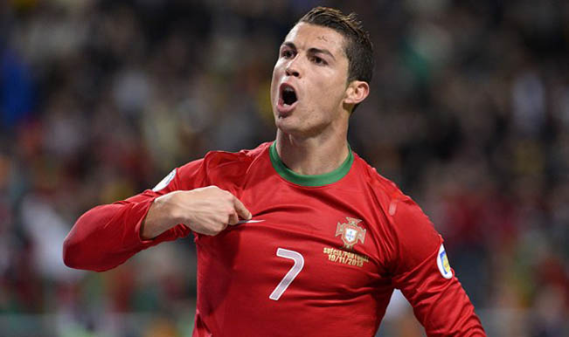
The Ricardian model
  We have a_{C} > a_{C}* and a_{W} > a_{W} *
  The unit labor requirements are lower in Portugal in both wine and cloth
  Portugal has an absolute advantage in both goods
  Portugal is better than the UK at everything
*

Slide 51
The Ricardian model
  If we compare relative productivities:
    We have a_{C} /a_{W} > a_{C}* /a_{W}* (2/3 >1/2)
    Equivalently, a_{C} / a_{C}* > a_{W} /a_{W}* (2/1 >3/2)
  Portugal’s domiance is even bigger in cloth
    The UK has a comparative advantage in wine

Slide 52
The Ricardian model
  The UK has a comparative advantage in wine
What happens if the UK specializes in wine and Portugal in cloth?
Will they trade? And if so, at which prices?

Slide 53
The Ricardian model
  Prices:
    P_{C} : the price of cloth
    P_{w} : the price of wine
    P_{C} /P_{w}: the relative price of cloth in terms of wine
    The relative price of cloth in terms of wine is the amount of wine that can be exchanged for a sweater

Slide 54

The Ricardian model
  Relative prices:
    “How much for that sweater?”
    “That’ll be 3 bottles sir”

Slide 55
The Ricardian model
    The amounts of each good produced are determined by prices
      If P_{C} /P_{w} > a_{C} /a_{w}, the relative price of cloth is higher than the relative cost, no one will produce wine (complete specialization in textile).
      If P_{C} /P_{w} < a_{C} /a_{w}, the relative price of cloth is lower than the relative cost, no one will produce sweaters (complete specialization in wine).
    If both goods are produced, we have P_{C} /P_{w} = a_{C} /a_{w}
      In autarky, relatives prices equal relative costs

Slide 56
The Ricardian model
    The amounts of each good produced are determined by prices
      If P_{C} /P_{w} > a_{C} /a_{w}, the relative price of cloth is higher than the relative cost, no one will produce wine (complete specialization in textile).
      If P_{C} /P_{w} < a_{C} /a_{w}, the relative price of cloth is lower than the relative cost, no one will produce sweaters (complete specialization in wine).
    If both goods are produced, we have P_{C} /P_{w} = a_{C} /a_{w}
      In autarky, relatives prices equal relative costs

Slide 57
The Ricardian model
  In autarky, relatives prices equal relative costs
  What determines the relative price after trade?
    To answer this question we have to define the relative supply and relative demand for cloth in the world as a whole
    The relative supply of cloth equals the total quantity of cloth supplied by both countries at each given relative price divided by the total quantity of wine supplied, (Q_{C} + Q*_{C} )/(Q_{W} + Q*_{W})

Slide 58
The Ricardian model
World Relative Supply and Demand
Relative price
of cloth, P_{C}/P_{W}
a_{C}/a_{W}
RS
a*_{C}/a*_{W}
L/a_{C}*
L/a_{W}
Relative quantity
of cloth, Q_{C} + Q*_{C}
Q_{W} + Q*_{W}

Slide 59
The Ricardian model
World Relative Supply and Demand
Relative price
of cloth, P_{C}/P_{W}
a_{C}/a_{W}
RS
No supply of cloth if relative price below relative cost
a*_{C}/a*_{W}
L/a_{C}*
L/a_{W}
Relative quantity
of cloth, Q_{C} + Q*_{C}
Q_{W} + Q*_{W}

Slide 60
The Ricardian model
World Relative Supply and Demand
Relative price
of cloth, P_{C}/P_{W}
a_{C}/a_{W}
RS
If relative price = a*_{C}/a*_{W}
Portugal can produce any relative quantities of cloth of wine. RS is flat.
a*_{C}/a*_{W}
L/a_{C}*
L/a_{W}
Relative quantity
of cloth, Q_{C} + Q*_{C}
Q_{W} + Q*_{W}

Slide 61
The Ricardian model
World Relative Supply and Demand
Relative price
of cloth, P_{C}/P_{W}
a_{C}/a_{W}
RS
If relative price > a*_{C}/a*_{W}
Portugal will specialize in cloth and produce L/a*_{C}
If relative price < a_{C}/a_{W}
UK will produce L/a_{W} wine
a*_{C}/a*_{W}
L/a_{C}*
L/a_{W}
Relative quantity
of cloth, Q_{C} + Q*_{C}
Q_{W} + Q*_{W}

Slide 62
The Ricardian model
World Relative Supply and Demand
Relative price
of cloth, P_{C}/P_{W}
a_{C}/a_{W}
RS
Hence if the price is between a*_{C}/a*_{W} and a_{C}/a_{W,} the RS is
a*_{C}/a*_{W}
L/a_{C}
L*/a*_{W}
Relative quantity
of cloth, Q_{C} + Q*_{C}
Q_{W} + Q*_{W}

Slide 63
The Ricardian model
World Relative Supply and Demand
Relative price
of cloth, P_{C}/P_{W}
a_{C}/a_{W}
RS
If relative price = a_{C}/a_{W}
UK can produce any relative quantities of cloth of wine. RS is flat.
a*_{C}/a*_{W}
L/a_{C}*
L/a_{W}
Relative quantity
of cloth, Q_{C} + Q*_{C}
Q_{W} + Q*_{W}

Slide 64
The Ricardian model
World Relative Supply and Demand
Relative price
of cloth, P_{C}/P_{W}
a_{C}/a_{W}
RS
If relative price > a_{C}/a_{W}
Portugal and UK will produce cloth and RS is infinite (Q_{W} + Q*_{W}=0)
.
a*_{C}/a*_{W}
L/a_{C}*
L/a_{W}
Relative quantity
of cloth, Q_{C} + Q*_{C}
Q_{W} + Q*_{W}

Slide 65
The Ricardian model
World Relative Supply and Demand
Relative price
of cloth, P_{C}/P_{W}
a_{C}/a_{W}
RS
If relative price increases, the RD decreases.
RD
a*_{C}/a*_{W}
L/a_{C}*
L/a_{W}
Relative quantity
of cloth, Q_{C} + Q*_{C}
Q_{W} + Q*_{W}

Slide 66
The Ricardian model
World Relative Supply and Demand
Relative price
of cloth, P_{C}/P_{W}
a_{C}/a_{W}
RS
1
At point 1, the price is between the relative costs, so each country specializes in its comparative advantage. UK does wine, Portugal cloth.
RD
a*_{C}/a*_{W}
L/a_{C}*
L/a_{W}
Relative quantity
of cloth, Q_{C} + Q*_{C}
Q_{W} + Q*_{W}

Slide 67
The Ricardian model
World Relative Supply and Demand
Relative price
of cloth, P_{C}/P_{W}
a_{C}/a_{W}
RS
1
2
RD
a*_{C}/a*_{W}
RD'
Q'
L/a_{C}*
L/a_{W}
Relative quantity
of cloth, Q_{C} + Q*_{C}
Q_{W} + Q*_{W}

Slide 68
The Ricardian model
World Relative Supply and Demand
Relative price
of cloth, P_{C}/P_{W}
a_{C}/a_{W}
RS
If RD shifted to RD’, the relative price would equal a_{C}/a_{W}.
Portugal will produce both wine and cloth, the UK only wine.
1
2
RD
a*_{C}/a*_{W}
RD'
Q'
L/a_{C}*
L/a_{W}
Relative quantity
of cloth, Q_{C} + Q*_{C}
Q_{W} + Q*_{W}

Slide 69
The Ricardian model
Recap:
  The amounts of each good produced are determined by relative prices
  Relative prices are determined by relative supply and demand

Slide 70
The Ricardian model
As a rule of thumb, world prices usually converge between the two countries’ autarky prices
Recall the autarky prices were
  In the UK P_{C} /P_{w} = a_{C} /a_{w}=2/3
  In Portugal P_{C} */P_{w} *= a_{C}* /a_{w}*=1/2
 | UK | Portugal
A bottle of wine | a_{W}=3 | a_{W}*=2
A sweater | a_{c}=2 | a_{c}*=1

Slide 71
The Ricardian model
As a rule of thumb, world prices usually converge between the two countries’ autarky prices
Recall the autarky prices were
  In the UK P_{C} /P_{w} = a_{C} /a_{w}=2/3
  In Portugal P_{C}*/P_{w}*= a_{C}*/a_{w}*=1/2
Let’s assume the world price converges to 3/5 (between 2/3 and ½)

Slide 72
The Ricardian model
Production possibility frontiers
wine
production,
in bottles
The UK specializes in wine
L/a_{W}*=300
L/a_{W}=200
L/a_{c}*=600
L/a_{c}=300
sweater
production

Slide 73
The Ricardian model
Production possibility frontiers
wine
production,
in bottles
The UK specializes in wine
Portugal in cloth
L/a_{W}*=300
L/a_{W}=200
L/a_{c}*=600
L/a_{c}=300
sweater
production

Slide 74
The Ricardian model
Production possibility frontiers
wine
production,
in bottles
The UK specializes in wine
It can exchange its 200 bottles against 333 at a price of 3/5 (5 sweaters for 3 bottles)
L/a_{W}*=300
L/a_{W}=200
L/a_{c}*=600
L/a_{c}=300
sweater
production

Slide 75
The Ricardian model
Production possibility frontiers
wine
production,
in bottles
The UK specializes in wine
It can exchange its 200 bottles against 333 at a price of 3/5 (5 sweaters for 3 bottles)
Its consumption possibility increases to 333 sweaters ➔ Gains from trade for the UK
L/a_{W}*=300
L/a_{W}=200
L/a_{c}*=600
L/a_{c}=300
333
sweater
production

Slide 76
The Ricardian model
Production possibility frontiers
Portugal specializes in cloth
It can buy the 200 bottles of wine produced in the UK at a price of 333 sweaters (5 sweaters for 3 bottles)
Its consumption possibility increases to a mix of 200 bottles and 267 sweaters.
(To consume 200 bottles in autarky, Portugal could only consume 200 sweaters)
wine
production,
in bottles
L/a_{W}*=300
L/a_{W}=200
L/a_{c}*=600
L/a_{c}=300
333
sweater
production

Slide 77
The Ricardian model
Production possibility frontiers
wine
production,
in bottles
Consumption possibilities increase from A to B
Gains from trade for Portugal
L/a_{W}*=300
A
B
L/a_{W}=200
L/a_{c}*=600
200
267
L/a_{c}=300
333
sweater
production

Slide 78
The Ricardian model
Recap:
  The preceding graph shows that both countries’ consumption possibilities expand when they both specialize in their comparative advantage
  This is a way to visualise gains from trade

Slide 79
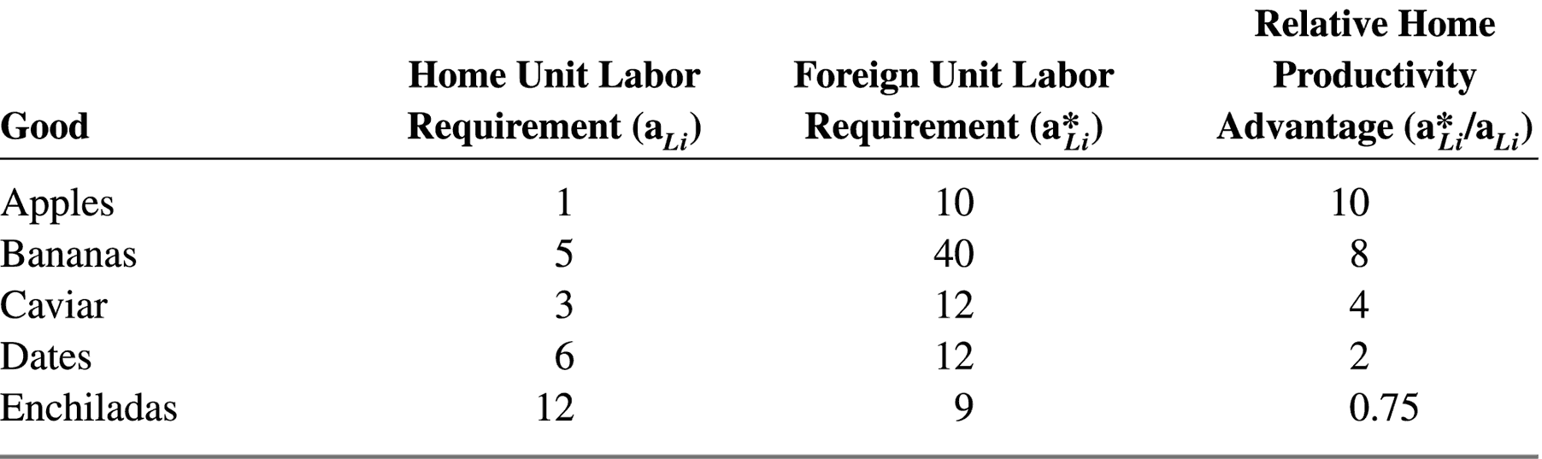
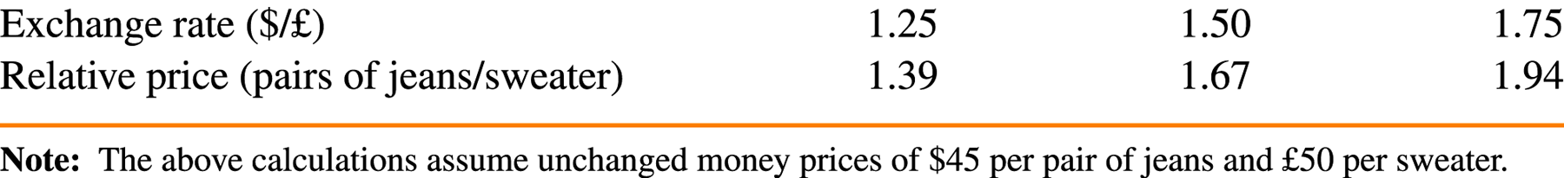
Comparative Advantage with Many Goods

Slide 80
Comparative Advantage with Many Goods
Home is 10 times more productive in Apple production

Slide 81
Comparative Advantage with Many Goods
Which country produces which goods?
  A country has a cost advantage in any good for which its relative productivity is higher than its relative wage
  If, for example, w/w* = 3, Home will produce apples, bananas, and caviar, while Foreign will produce only dates and enchiladas.

Slide 82
Comparative Advantage with Many Goods
Which country produces which goods?
  A country has a cost advantage in any good for which its relative productivity is higher than its relative wage
  If, for example, w/w* = 3, Home will produce apples, bananas, and caviar, while Foreign will produce only dates and enchiladas.
  Relative wages are determined by the RS and RD for labour

Slide 83
Comparative Advantage with Many Goods
Determination of Relative Wages
Relative wage
Rate, w/w*
RS
Apples
10
Bananas
8
Caviar
4
3
Dates
2
Enchiladas
0.75
RD
Relative quantity
of labor, L/L*

Slide 84
Comparative Advantage with Many Goods
Determination of Relative Wages
Relative wage
Rate, w/w*
RS
The RS of labour is fixed as it’s determined by the sizes of the labour forces which we assume don’t change.
Apples
10
Bananas
8
Caviar
4
3
Dates
2
Enchiladas
0.75
RD
Relative quantity
of labor, L/L*

Slide 85
Comparative Advantage with Many Goods
Determination of Relative Wages
Relative wage
Rate, w/w*
RS
The RD of labour decreases in the relative wage rate.
Apples
10
Bananas
8
Caviar
4
3
Dates
2
Enchiladas
0.75
RD
Relative quantity
of labor, L/L*

Slide 86
Comparative Advantage with Many Goods
Determination of Relative Wages
Relative wage
Rate, w/w*
The RD curse has steps:
If the relative wage crosses a threshold relative productivity, the pattern of specialization changes and so does the demand for labour.
RS
Apples
10
Bananas
8
Caviar
4
3
Dates
2
Enchiladas
0.75
RD
Relative quantity
of labor, L/L*

Slide 87
Comparative Advantage with Many Goods
Determination of Relative Wages
Relative wage
Rate, w/w*
If the wages go from 3 times as high at Home to 5 times, Home stops producing caviar, hence its demand for labour goes down by a step
RS
Apples
10
Bananas
8
Caviar
4
3
Dates
2
Enchiladas
0.75
RD
Relative quantity
of labor, L/L*

Slide 88
Comparative Advantage with Many Goods
Recap:
  With many goods, the pattern of specialization is determined by the relative wages and relative productivities
  The relative wages are determined by the RS and RD of labour curves

Slide 89
How about a 10 min summary from the Khan Academy?
https://www.youtube.com/watch?v=xN3UV5FsBkU#t=363

Slide 90
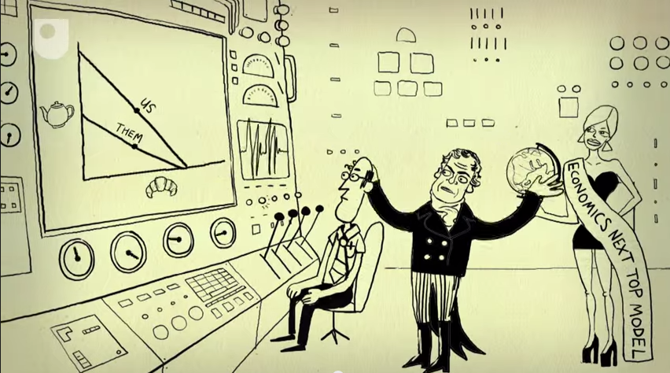
Recap
Countries can gain from trade if they specialize in their comparative advantage
That is because specialization and trade expand consumption possibilities

Slide 91
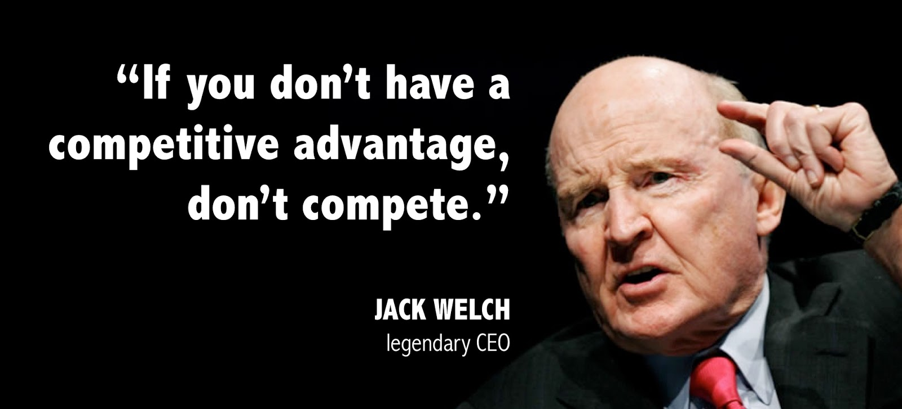
Recap

Slide 92
Recap
  Myth #1: Free trade is beneficial only if a country is strong enough to withstand foreign competition.

Slide 93
Recap
    3. Everyone has a comparative (competitive) advantage!
  Myth #1: Free trade is beneficial only if a country is strong enough to withstand foreign competition.

Slide 94
Recap
“Its chief service was to correct the previously prevalent error that under free trade all commodities would necessarily tend to be produced in the locations where their real costs of production were lowest”
  Jacob Viner on Ricardo’s theory (1937)

Slide 95
Taking the theory to the data
  Do productivity differences explain why countries trade in the real world?
  Does opening-up to trade lead to higher consumption?

Slide 96
Does opening-up to trade lead to higher consumption?
What we need are natural experiments where a country swicthes from autarky to free trade, or vice versa
The literature provides three such experiments:
  The Jeffersonian Embargo
  The opening up of Japan
  The Gaza blockade

Slide 97
The Jeffersonian Embargo
During the Napoleon wars (around 1805) between France and Britain, both countries tried to cut the other off from international trade
The US suffered as the British Navy was seizing US merchant ships
The US president, Thomas Jefferson, declared a complete ban on overseas shipping (hoping it would hurt Britain more than the US)

Slide 98
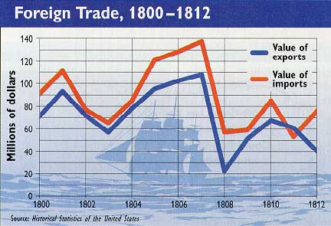
The Jeffersonian Embargo

Slide 99
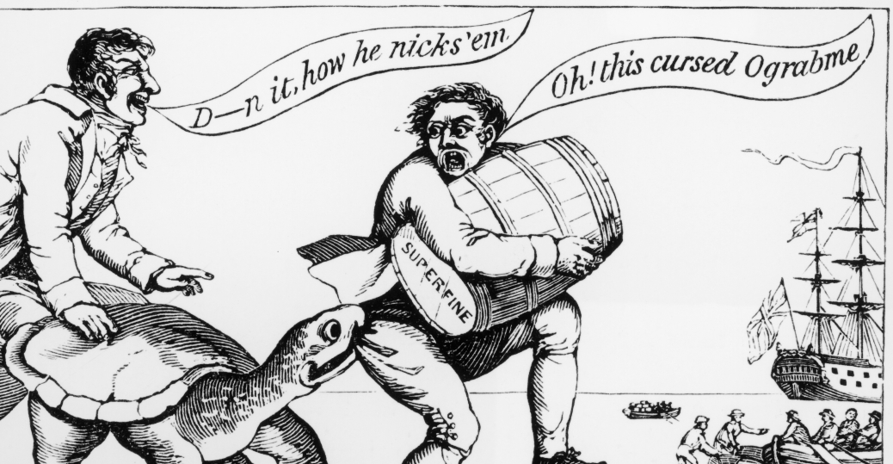
The Jeffersonian Embargo

Slide 100

The Jeffersonian Embargo
Economic historian Doug Irwin suggests that this is a unique episode where we can observe what happens when trade stops suddenly
He suggests that real income dropped 8% due to the embargo
➔ Autarky is costly!

Slide 101
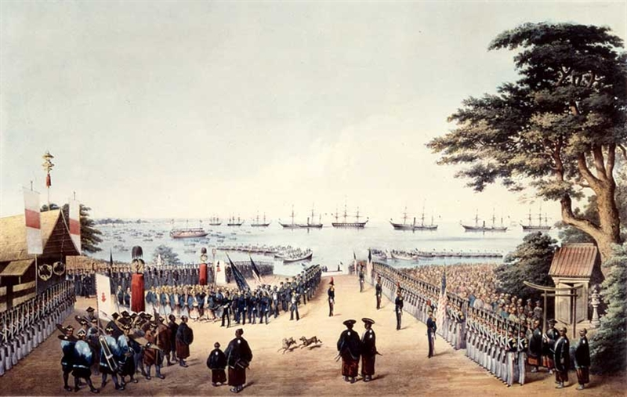
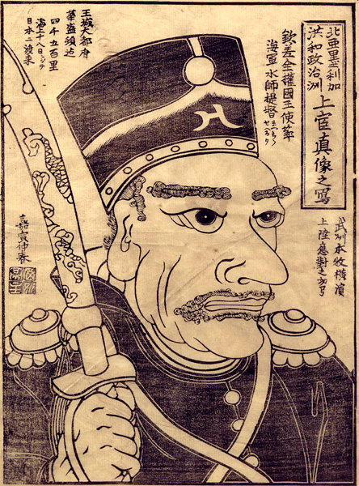
Japan’s opening up
Another such experiment is Japan’s sudden and complete opening up to international trade in the 1860s

Slide 102
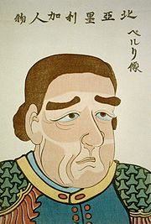
Japan’s opening up
For two centuries known as the Edo period, Japanese ports were closed to foreign trade
In 1854 Japan and the US signed a historic treaty. A US naval officer, Commodore Perry, negotiated with Japanese officials to open the doors of trade with Japan

Slide 103
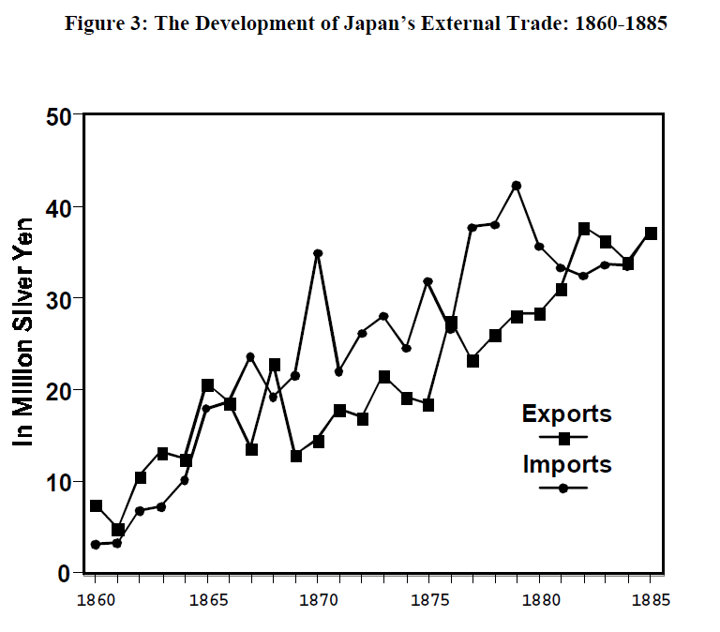

Slide 104
Japan’s opening up
To see what happened to consumption possibilities, Bernhofen and Brown use detailed product-specific data on autarky prices
Autarky prices incorporate all relevant information about a country’s opportunity costs
If opening up involves specialization along comparative advantage, goods with relatively high autarky prices will be imported and goods with relatively low autarky prices will be exported

Slide 105
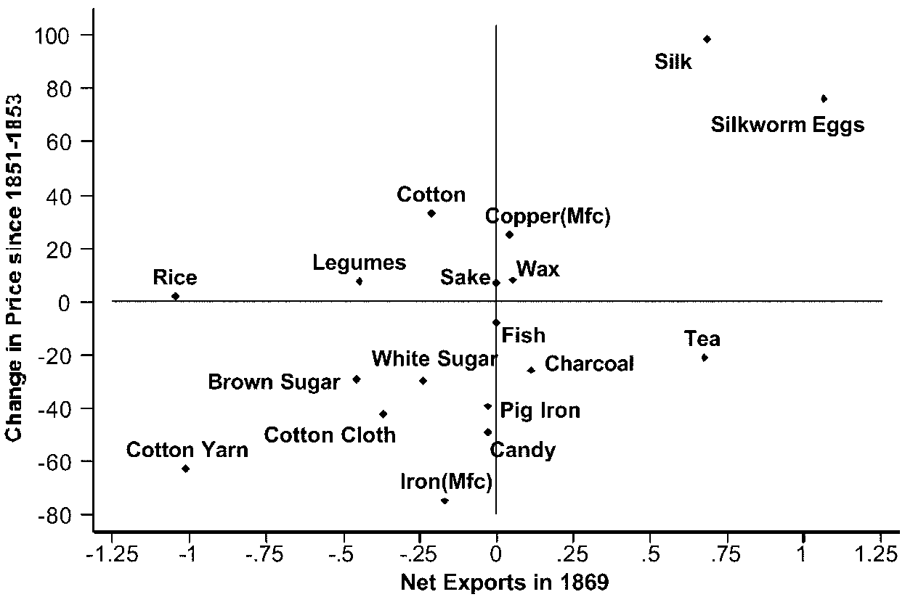
Japan’s opening up

Slide 106
Japan’s opening up
Example:
  P_{sugar}/P_{silk} was higher in Japan than in its trading partner during autarky
  Japan had a comparative advantage in silk
  With free trade, prices converged:
    P_{sugar}/P_{silk} decreased in Japan ➔ P_{sugar ,} P_{silk}
    Japan started exporting silk and importing sugar, along its comparative advantage

Slide 107
Japan’s opening up
Recap:
  Japan’s opening up led to price convergence
  It started exporting goods for which its autarky prices were relatively lower

Slide 108
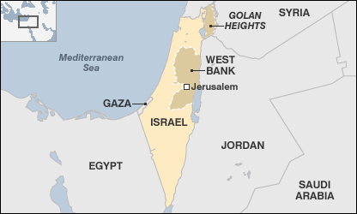
The Gaza blockade
Gaza Strip came close to being autarkic, as a result of an Israeli and Egyptian blockade that was imposed between 2007 and 2010

Slide 109
The Gaza blockade
What can the blockade on the Gaza Strip teach us about the gains from trade?
Economists Haggay Etkes and Assaf Zimring looked at trade, employment and price data to look at the consequences of the blockade on the Gaza economy

Slide 110
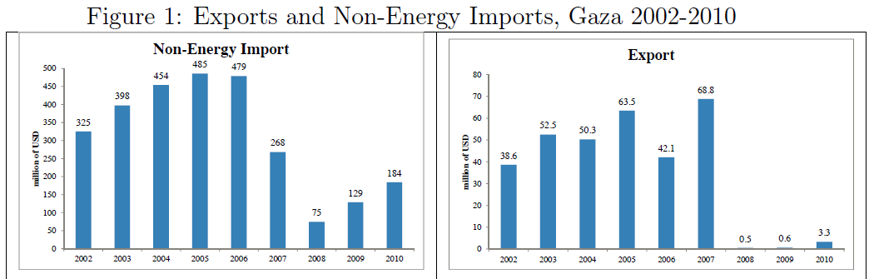
The Gaza blockade

Slide 111
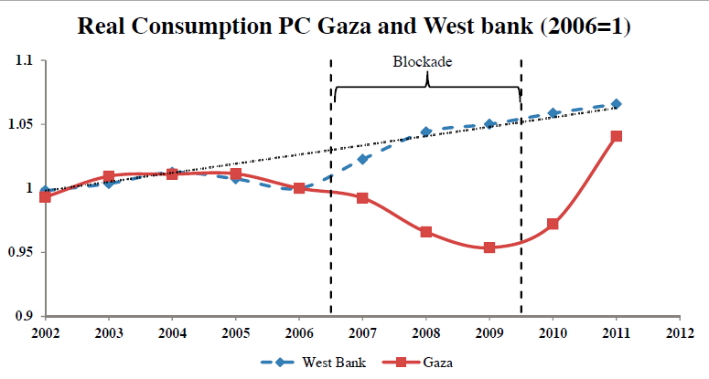
The Gaza blockade

Slide 112
The Gaza blockade
The blockade resulted in a welfare loss around 14%-27%
Access to world markets allow the Gaza economy to better allocate it factors of production

Slide 113
Recap
Natural experiments where countries switch abruptly from free trade to autarky or vice versa can help us quantify the gains from trade

Slide 114
But does the Ricardian model explain world trade patterns?
Do countries export those goods in which their productivity is relatively high?
Bela Balassa compared the ratio of US and UK exports with their ratio of labour productivity in 1951

Slide 115
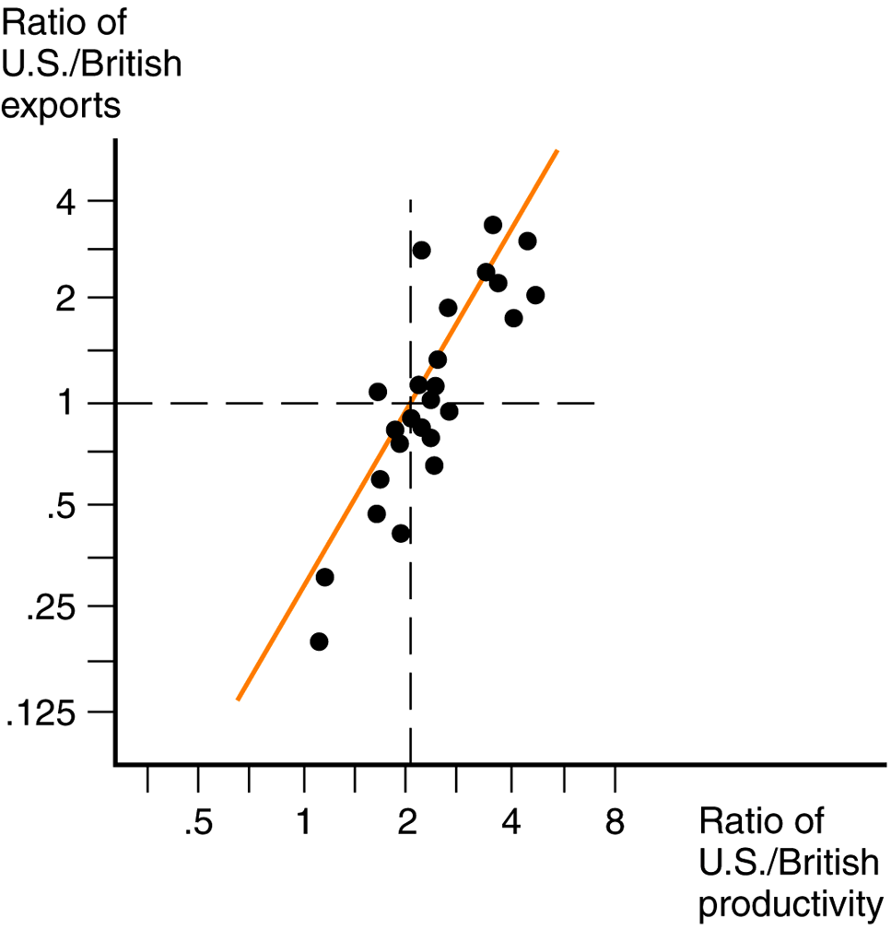
But does the Ricardian model explain world trade patterns?
In that year, US productivity exceeded UK productivity in all sectors

Slide 116
But does the Ricardian model explain world trade patterns?
Yet this exercise only include goods that are exported by both countries
Most countries never produced a whole range of goods
So how can we know how the observed productivities and trade flows compare to autarky if we cannot observe it?

Slide 117
But does the Ricardian model explain world trade patterns?
Dave Donaldson and Arnaud Costinot suggest that we can observe hypothetical agricultural productivity
Agronomists are able to predict how productive a given parcel of land would be were it to be used to grow any one of a set of crops
Economists can compute hypothetical relative productivities for 17 crops in 55 countries

Slide 119
But does the Ricardian model explain world trade patterns?
How do output levels predicted by Ricardo’s theory compare to those that are observed in the data?
  Quite well!
“Ricardo’s theory of comparative advantage is not just mathematically correct and non-trivial; it also has significant explanatory power in the data”

Slide 120
But does the Ricardian model explain world trade patterns?
Another way to test for Ricardo's theory is to think of different sources of comparative advantage

Slide 121
Can good institutions be a source of comparative advantage?
Some countries are better than others at enforcing contracts
You can think of these countries as having better “institutions”

Slide 122
Can good institutions be a source of comparative advantage?
The production of some complex goods require a multitude of contracts with suppliers of parts
You can think of these goods as contract-intensive goods

Slide 123
Can good institutions be a source of comparative advantage?
The cost of producing goods depends on the country’s “institutions” and the goods’ “contract-intensity”
The difference in production costs between the good-institution and the bad-institution country is even higher in contract-intensive products
  The bad-institution country has a comparative advantage in goods with a low contract intensity

Slide 124

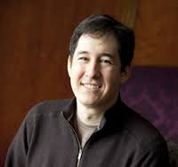
Can good institutions be a source of comparative advantage?
Nathan Nunn and Andrei Levchenko classified goods in terms of their contract-intensity
This index allows us to infer the relative costs of goods even if they are not produced

Slide 125
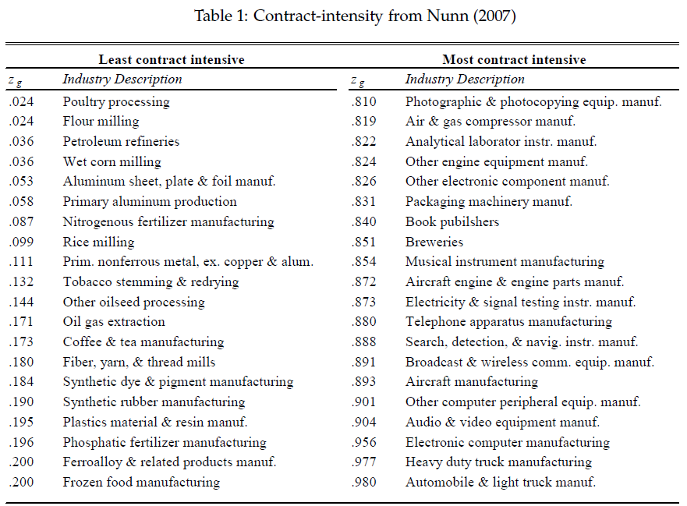

Slide 126
Can good institutions be a source of comparative advantage?
In separate studies they both found that countries with good institutions specialize and export in industries where contract enforcement is most important
Countries with bad institutions export more `simple’ goods, in which they have a comparative advantage

Slide 127
But does the Ricardian model explain world trade patterns?
Recap:
  Ricardo’s theory can be hard to test empirically
  Still, many ingenuous studies have shown that the theory is quite successful at explaining trade patterns

Slide 128
Trade policy implications
But what are the trade policy implications?
Should countries specialize and trade? And everybody wins?

Slide 129


Comparative advantage: It’s TRUE…
Comparative advantage: It’s TRUE… especially in the context of hotdogs and cupcakes

Slide 130
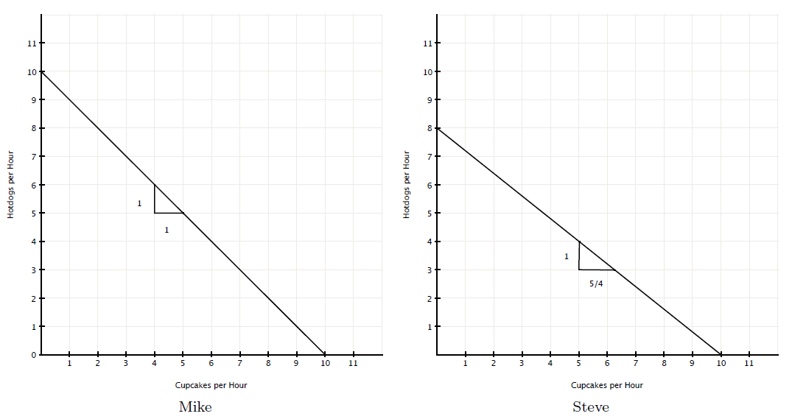
Flatmates Mike and Steve

Slide 131
Flatmates Mike and Steve
Mike has a comparative advantage in hotdogs!

Slide 132
Flatmates Mike and Steve
Mike does hotdogs and Steve cupcakes and they expand their flat’s consumption possibilities!
Mike has a comparative advantage in hotdogs!

Slide 133

Comparative advantage: It’s TRUE…
If your partner is great at grocery shopping and you are great at the laundry, you’re set.
But often one person is better at everything
Does that mean he or she should have to do everything?
No! Comparative-advantage specialization will be more efficient!

Slide 134
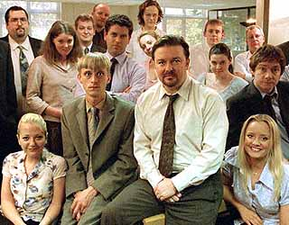
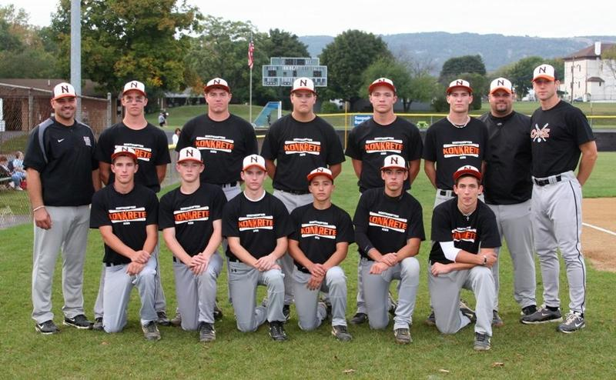
Comparative advantage: It’s TRUE…
… especially in the context of workplaces and… baseball teams

Slide 135
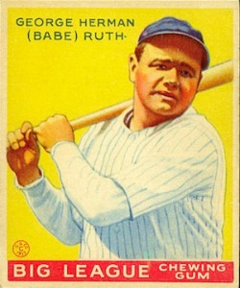
Comparative advantage: It’s TRUE…
Babe Ruth was an amazing pitcher (the best of his team) as well as the best slugger of all time
His team manager figured out that his team would actually be better if he specialized in slugging
Although he had an absolute advantage in pitching, his skill as a batter was even greater relative to his teammates
He went on to establish many batting records and win 7 World Series

Slide 136

Trade policy implications
So… countries specialize and trade? And everybody wins?
Not so fast… Ricardo Hausmann, talks about The Specialization Myth
“In the process of development, … countries do not specialize; they diversify.”

Slide 137
Trade policy implications
“Yes, people do specialize, and they should specialize, too. Everyone benefits from each of us becoming good at different things and exchanging our knowhow with others. It is not efficient for a dentist and a lawyer, for example, to be the same person.”
“But specialization at the individual level actually leads to diversification at a higher level. It is precisely because individuals and firms specialize that countries diversify”

Slide 138
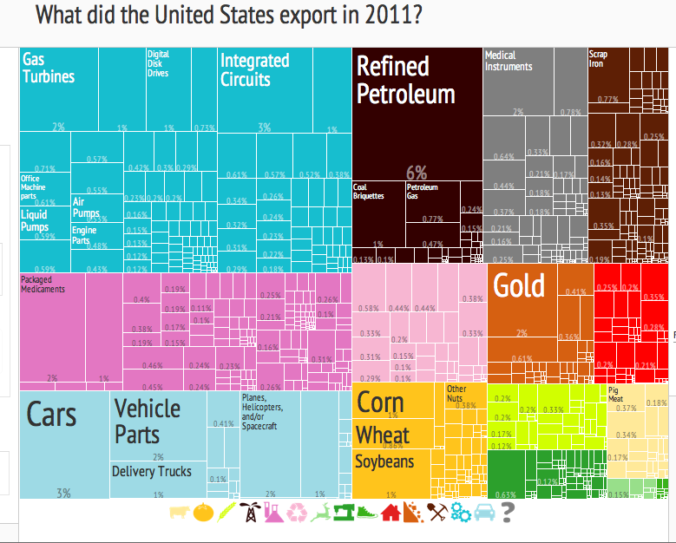
Trade policy implications

Slide 139
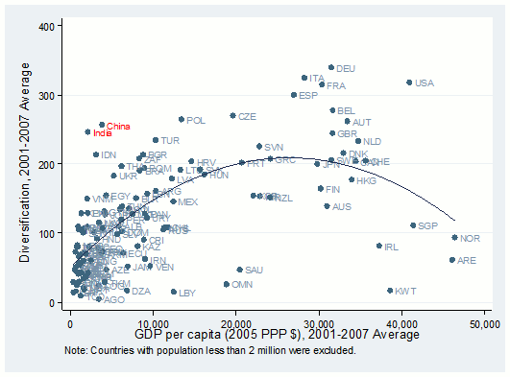
Trade policy implications

Slide 140
Trade policy implications
Recap:
  Applying the theory of comparative advantage to policy advice is not as easy as “countries should specialize”

Slide 141
Bonus material
More ways of looking at gains from trade

Slide 142
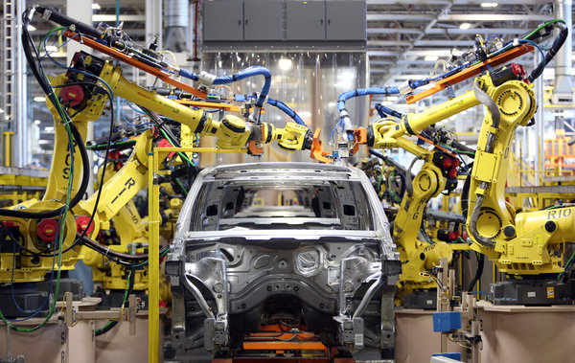
The Iowa car crop
David Friedman suggested there are two technologies for producing cars in America
  1. manufacture them in Detroit

Slide 143
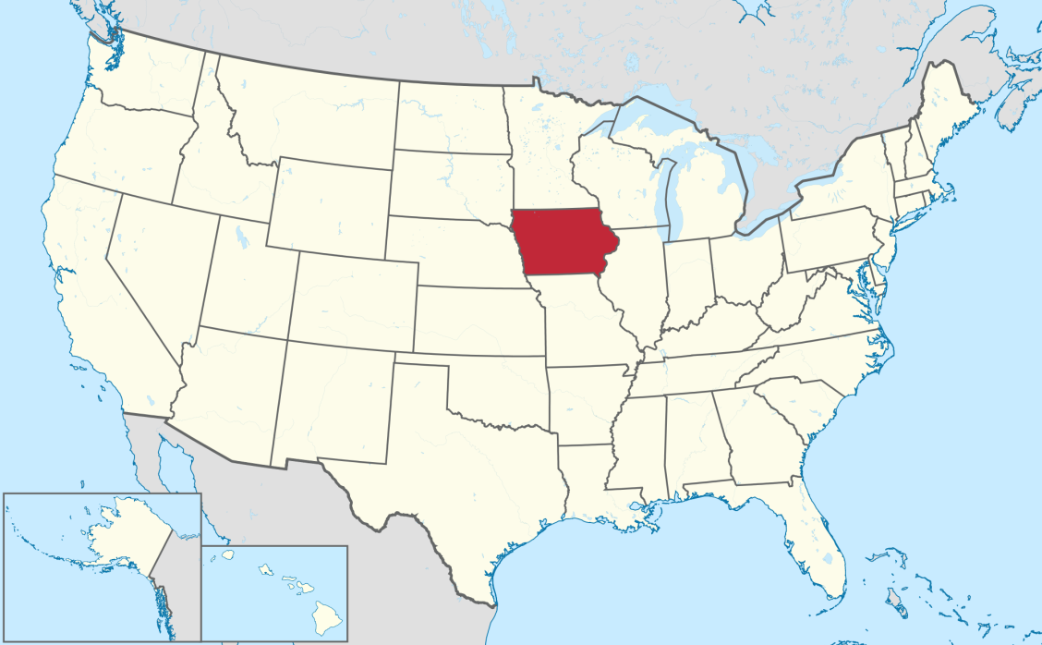
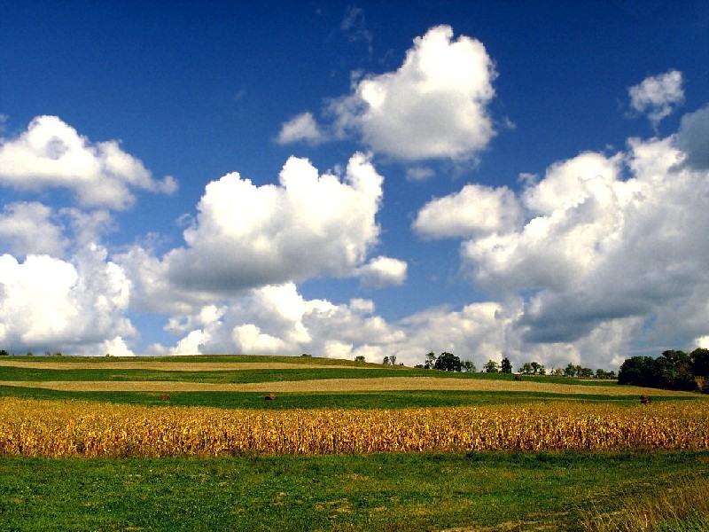
The Iowa car crop
David Friedman suggested there are two technologies for producing cars in America
  1. manufacture them in Detroit
  2. grow them in Iowa

Slide 144
The Iowa car crop
“First you plant seeds, which are the raw material from which automobiles are constructed. You wait a few months until wheat appears. Then you harvest the wheat, load it onto ships, and sail the ships eastward into the Pacific Ocean. After a few months, the ships reappear with Toyotas on them.”

Slide 145

The Iowa car crop
International trade is nothing but a form of technology
To analyse trade policies, we might as well assume that Japan is a giant machine with mysterious inner workings that convert wheat into cars

Slide 146

Trade as technological progress
This idea is actually older than Ricardo's
The term free trade applied to international policy came in the mid-1690s when the East India Company began shipping huge quantities of cotton from India to England
These imports adversely affected domestic production of cotton goods, sparking a clamour for restrictions on imports and triggering the first real debate in England

Slide 147
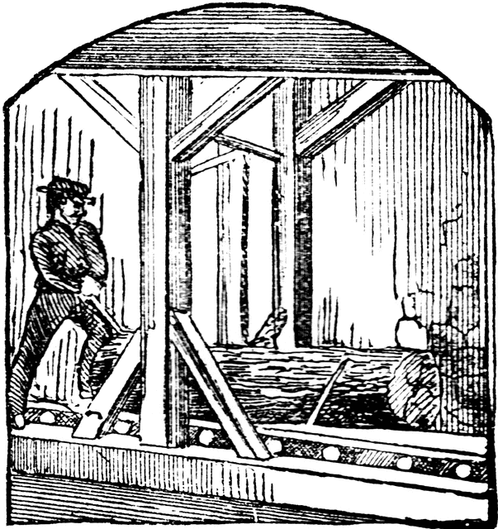
Trade as technological progress
Henry Martyn’s “Considerations upon the East-India trade” (1701)
He might have proposed, way before Ricardo, the killer argument for free trade
Take the sawmill
It allows 2 men to do the work of 30 in the same amount of time

Slide 148
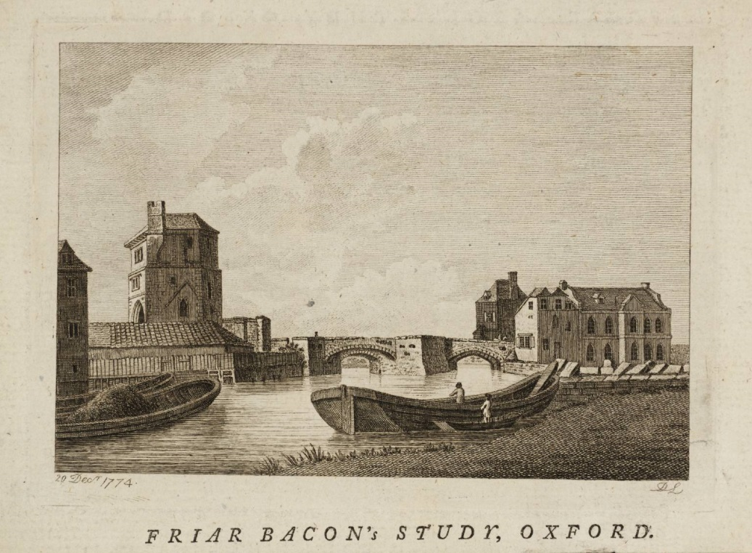
Trade as technological progress
Take the barge on a river
It allows 5 men to carry as much freight as 100 horses and men on land

Slide 149
Trade as technological progress
If we neglect the sawmill and the river, we’d put many more men to work
But wouldn’t that be a waste of labor?
  Does England gain from having people employed so uselessly?

Slide 150
Trade as technological progress
The clincher:
  Wouldn’t it be a similar waste to employ workers in England if the textiles can be obtained from India by putting fewer people to work?
If, by trading, we can obtain the same quantity of textile by working less, trade can be thought of as a technology

Slide 151
Trade as technological progress
It would be silly to deny the nation of sawmills and barges
Isn’t it equally silly to deny the nation of cheap imports from India?

Slide 152
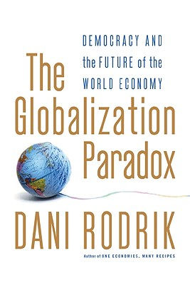
Trade as technological progress
The anecdote is taken from “The Globalization Paradox”

Slide 153
Recap
A powerful argument for free trade is that it can be simply thought of as a technology and hence it’d be silly to do without it

Slide 154
Conclusion?
RICARDO'S DIFFICULT IDEA (1996) by Paul Krugman
“Ricardo's idea is truly, madly, deeply difficult. But it is also utterly true, immensely sophisticated -- and extremely relevant to the modern world.”

