Slide 1
External Economies of Scale and Trade
Pierre-Louis Vézina
p.vezina@bham.ac.uk

Slide 3
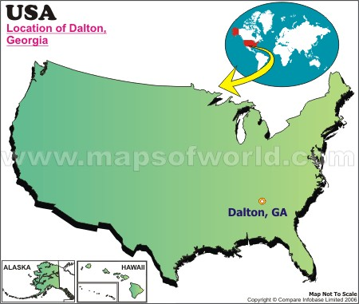

Slide 4
The carpet capital of the world
Dalton is the "Carpet Capital of the World", home to 150+ carpet plants
More than 90% of the functional carpet produced in the world today is made within a 65-mile radius of the city
Notes:
The agglomeration of the carpet industry in Dalton can be traced back to a wedding gift given in 1895 by a teenage girl, Catherine Evans Whitener, to her brother, Henry Alexander Evans, and his bride, Elizabeth Cramer. The gift was an unusual tufted bedspread. Copying a quilt pattern, she sewed thick cotton yarns with a running stitch into unbleached muslin, clipped the ends of the yarn so they would fluff out, and finally, washed the spread in hot water to hold the yarns by shrinking the fabric. Interest grew in young Catherine's bedspreads, and in 1900, she made the first sale of a spread for $2.50. Demand became so great for the spreads that by the 1930s, local women had "haulers", who would take the stamped sheeting and yarns to front porch workers. Often entire families worked to hand tuft the spreads for 10 to 25 cents per spread. Nearly 10,000 area cottage "tufters"—men, women, and children, were involved in the industry. Income generated by the bedspreads was instrumental in helping many area families survive the depression. Chenillebedspreads became amazingly popular all over the country and provided a new name for Dalton: the Bedspread Capital of the World.^{[14]}
When a form of mechanized carpet making was developed after World War II, Dalton became the center of the new industry because specialized tufting skills were required and the city had a ready pool of workers with those skills.^{[15]}
By the 1970s manufacturers had begun to develop techniques to move from plain tufted carpet to sculpted carpet. Improved patterning, stain and wear resistance, and colors have made today's tufted carpet the choice for functional carpet for the vast majority of homes and moved woven carpet to a decorative role.

Slide 5
The toothbrush capital of the world
Hangji, China
Pop: 36,000
Toothbrush production:
3 billion / year
990 toothbrush manufacturers
80% of China’s production
Started in 1827

Slide 6
Introduction
Why do industries cluster?
Understanding industrial clusters is key to understanding world trade

Slide 7
Introduction
According to the models we’ve seen so far, countries trade because they are different in technologies or endowments
Ricardo and Hecksher-Ohlin predict countries that are most different should trade more
Yet a lot of world trade is between similar countries

Slide 8
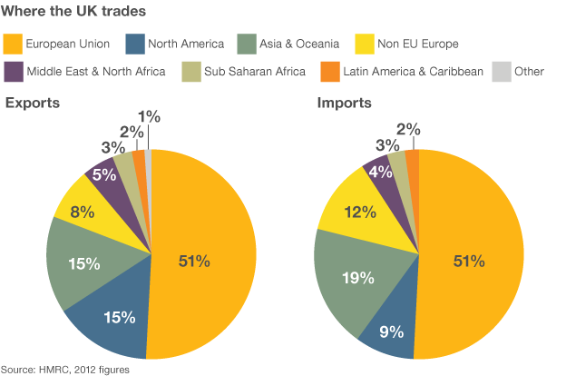
Introduction

Slide 9
Introduction
The models we studied thus far can’t explain this type of trade
What’s missing?

Slide 10
Introduction
The models thus far assumed constant returns to scale:
When inputs to an industry increase at a certain rate, output increases at the same rate.
If inputs were doubled, output would double as well.

Slide 11
Introduction
But there may be increasing returns to scale (or economies of scale)
This means that when inputs to an industry increase at a certain rate, output increases at a faster rate.
A larger scale is more efficient: the cost per unit of output falls as an industry increases output.

Slide 12
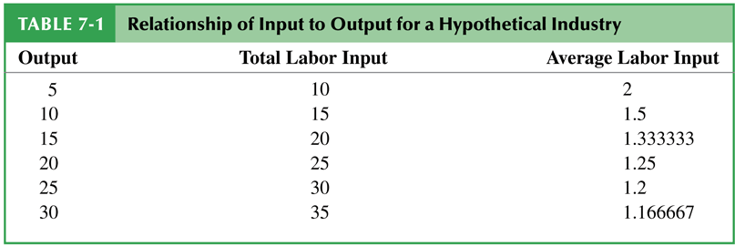
Economies of scale
Economies of Scale: Doubling the input of labor more than doubles the industry’s output.

Slide 13
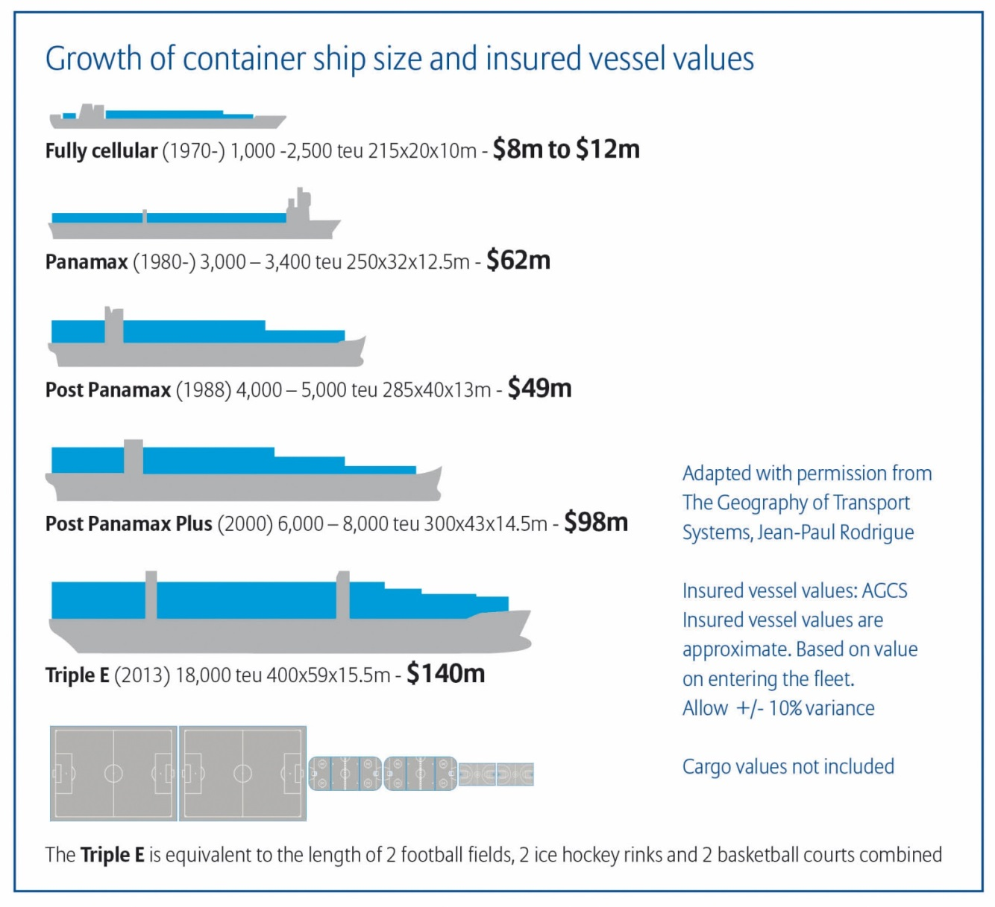
Economies of scale
Increasing the size of ships cuts the cost per container

Slide 14
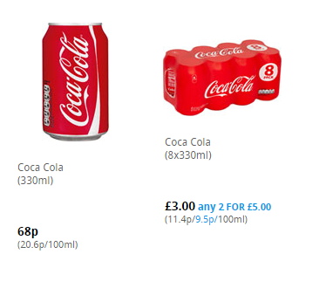
Economies of scale

Slide 15
Different types of Economies of Scale
Economies of scale could mean either that larger firms or a larger industry would be more efficient.
External economies of scale occur when cost per unit of output depends on the size of the industry.
Internal economies of scale occur when the cost per unit of output depends on the size of a firm.

Slide 16
Different types of Economies of Scale
External and internal economies of scale have different implications for the structure of industries:
An industry where economies of scale are purely external will typically consist of many small firms perfectly competitive.
Internal economies of scale result when large firms have a cost advantage over small firms, causing the industry to become imperfectly competitive.

Slide 17
Different types of Economies of Scale
We’ll focus on external economies of scale in this lecture
Next time we’ll see how internal economies of scale lead to monopolistic competition and trade

Slide 18
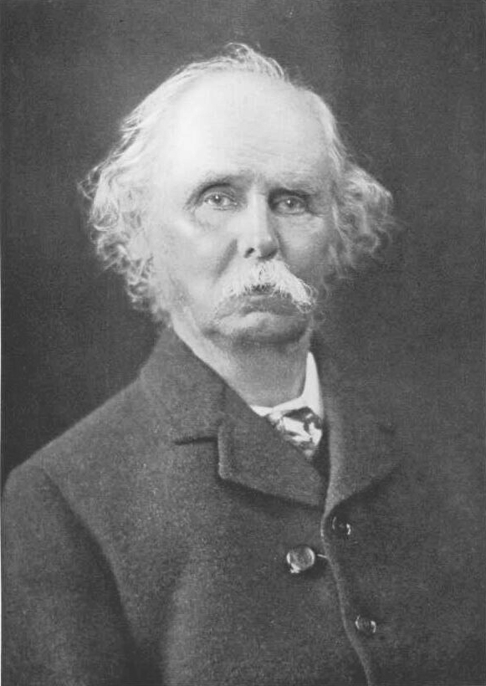
The Theory of External Economies
When an industry has thus chosen a locality for itself, it is likely to stay there long: so great are the advantages which people following the same skilled trade get from near neighbourhood to one another. The mysteries of the trade become no mysteries; but are as it were in the air, and children learn many of them unconsciously.
Good work is rightly appreciated, inventions and improvements in machinery, in processes and the general organization of the business have their merits promptly discussed: if one man starts a new idea, it is taken up by others and combined with suggestions of their own; and thus it becomes the source of further new ideas.
Alfred Marshall (1842-1924)

Slide 19
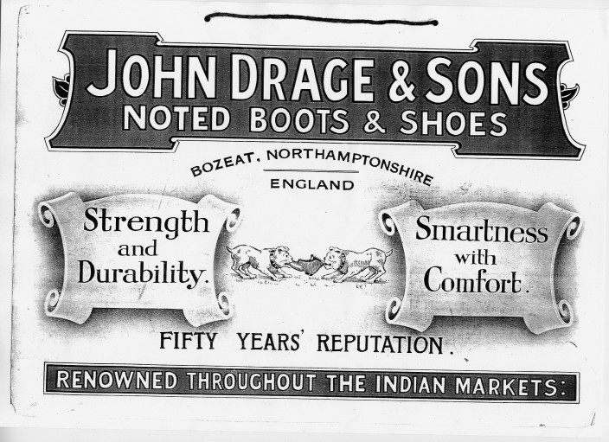
The Theory of External Economies
Industrial clusters:
Cutlery manufacturers in Sheffield
Shoes in Northampton

Slide 20
The Theory of External Economies
Many modern examples of industries seem to be powerful external economies:
In the US, the semiconductor industry is concentrated in Silicon Valley, investment banking in New York, and the entertainment industry in Hollywood

Slide 21
The Theory of External Economies
In China, external economies are pervasive in manufacturing
Toothbrushes in Hang Ji
Ties in Sheng Zhou
Lighters in Zhang Qi
Shoes in Wen Ling
Socks in Yiwu

Slide 22
The Theory of External Economies
Concentrating production of an industry in one location can reduce the industry’s costs, even if individual firms remain small.
E.g. 990 toothbrush firms

Slide 23
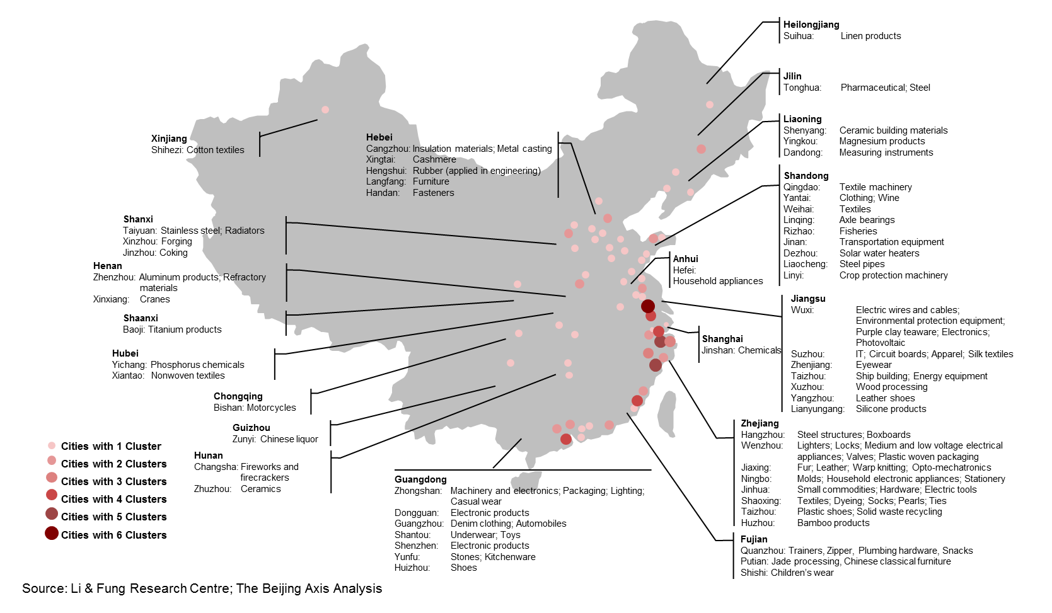
The Theory of External Economies

Slide 24
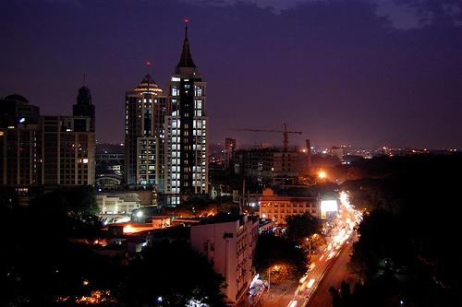
The Theory of External Economies
External economies played a key role in India’s emergence as a major exporter of information services.
Indian IT companies are clustered in Bangalore.
Notes:
In 1985,Texas Instruments became the first multinational corporation to set up base in Bangalore. Other information technology companies followed suit and by the end of the 20th century, Bangalore had established itself as the Silicon Valley of India

Slide 25
The Theory of External Economies
External economies may exist for a few reasons:
Specialized equipment or services
Labour pooling
Knowledge spillovers

Slide 26
The Theory of External Economies
Specialized equipment or services may be needed for the industry, but are only supplied by other firms if the industry is large and concentrated.
For example, Silicon Valley in California has a large concentration of silicon chip companies, which are serviced by companies that make special machines for manufacturing silicon chips.
These machines are cheaper and more easily available there than elsewhere

Slide 27
The Theory of External Economies
Specialized equipment or services
A 1994 study of Silicon Valley:
“engineers left established semiconductor companies to start firms that manufactured capital goods such as diffusion ovens, step-and-repeat cameras, and testers, and material and components such as photomask, testing jigs, and specialized chemicals… the independent equipment sector promoted the continuing formation of semiconductor firms by freeing individual producers from the expense of developing capital equipment internally and by spreading the cost of development. It also reinforced the tendency toward industrial localization, as most of these specialized inputs were not available elsewhere in the country”

Slide 28
The Theory of External Economies
Specialized equipment or services
If a car manufacturer had to produce all components (tires, airbags, brakes,…) in house, it would not be very efficient.
Specialized suppliers increase the efficiency of car manufacturers. Car manufacturers have an incentive to locate close to specialized suppliers.
Specialized suppliers also need enough customers close to them. Suppliers specialized in car components have an incentive to locate close to car manufacturers.
This circular causality brings about the geographical concentration of industries.
The greater the concentration of firms in a limited area, the more efficient the industry in that area will be.

Slide 29
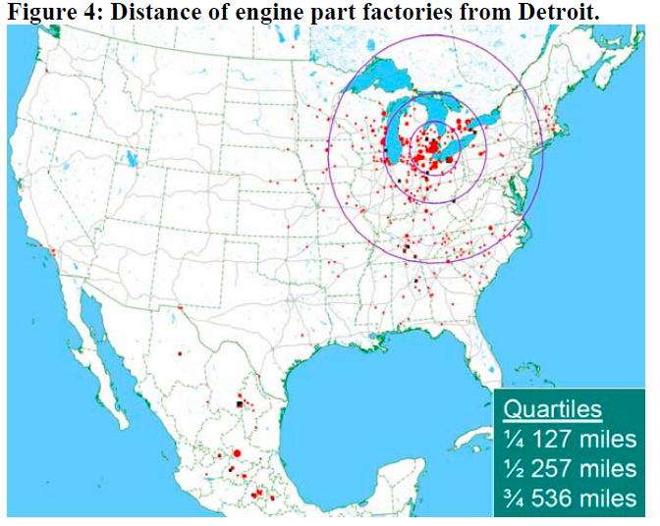
The Theory of External Economies

Slide 30
The Theory of External Economies
Sergio Marchionne, boss of Fiat-Chrysler, once said that 6m was the minimum production for car firms to be profitable
Bigger firms have lower average costs (Internal economies of scale)
In Japan, 5 smaller firms continue to prosper alongside 3 giants, Toyota, Nissan, Honda
Mazda, Mitsubishi, Suzuki, Subaru, Daihatsu

Slide 31
The Theory of External Economies
“Lots of oomph”, The Economist, 25 Oct 2014
“The Japanese small-fry are also more profitable than most firms in the industry”
“Japan’s small car firms are defying the industry’s get-big-or-die imperative”
A possible explanation?
A big industry → external economies of scale

Slide 32
The Theory of External Economies
Labour pooling (or a specialized labour market): a large and concentrated industry may attract a pool of workers, reducing employee search and hiring costs for each firm.

Slide 33
The Theory of External Economies
2 studios need experts in computer animation
With probability ½, a studio does well and wants to hire 150 workers, and with probability ½ a firm doesn’t do that well and wants to hire only 50 workers.
There are 200 experts in computer animation
Case 1, two cities (each with 100 workers and one studio)
Case 2, one city, (200 workers and 2 studios).

Slide 34
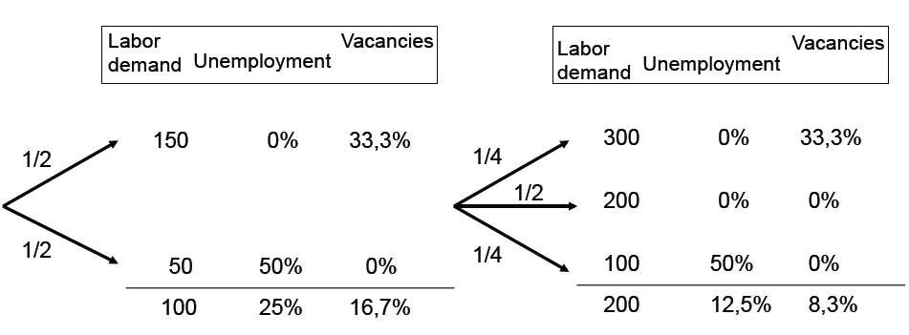
The Theory of External Economies
Case 1 (identical in the 2 cities)
Case 2

Slide 35
The Theory of External Economies
Case 1 (identical in the 2 cities)
Case 2
Each firm can expect 16.7% vacancy on average and each worker can expect 25% unemployment.

Slide 36
The Theory of External Economies
Case 1 (identical in the 2 cities)
Case 2
Each firm can expect 16.7% vacancy on average and each worker can expect 25% unemployment.
Each firm can expect 8.3% vacancy on average and each worker can expect 12.5% unemployment.

Slide 37
The Theory of External Economies
Firms that need specialized workers want to locate where there is a large supply of these workers.
Specialized workers want to be where there are a lot firms that need their skills.
As before, circular causality brings about the geographical concentration of industries.
Notes:
If a firm is doing well and needs more workers, it can easily find them.
If an employer does not get along with a worker, she can fire him and easily find another one (the employers aren’t prisoners of their employees).
If a worker loses a job (the firm isn’t doing well), she can easily find a job without having to change city or region.
If a worker doesn’t like the firm environment, she can easily find a job without having to change city or region (the employees aren’t prisoners of their employers).

Slide 38
The Theory of External Economies
Labour pooling
If you are an aspiring actor, you probably need to go live in Hollywood

Slide 39
The Theory of External Economies
Labour pooling
If you are an aspiring actor, you probably need to go live in Hollywood… or Bollywood

Slide 40
The Theory of External Economies
Labour pooling
If you are an aspiring actor, you probably need to go live in Hollywood… or Bollywood… or Nollywood

Slide 41
The Theory of External Economies
3. Knowledge spillovers: workers from different firms may more easily share ideas that benefit each firm when a large and concentrated industry exists (Remember Marshall’s quote)

Slide 42
The Theory of External Economies
Or this quote about workers in Silicon Valley in 1983:
“Every year there was some place, the Wagon Wheel, Chez Yvonne, Rickey's, the Roundhouse, where members of this esoteric fraternity, the young men and women of the semiconductor industry, would head after work to have a drink and gossip and brag and trade war stories about phase jitters, phantom circuits, bubble memories, pulse trains, bounceless contacts, burst modes, leapfrog tests, p-n junctions, sleeping-sickness modes, slow-death episodes, RAMs, NAKs, MOSes, PCMs, PROMs, PROM blowers, PROM burners, PROM blasters, and teramagnitudes”

Slide 43
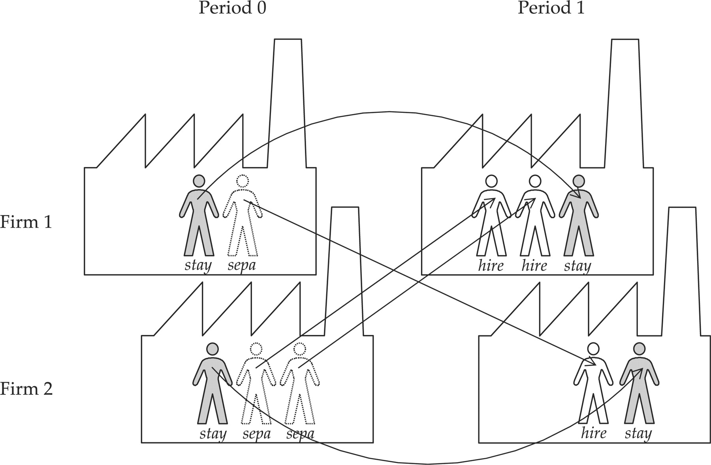
The Theory of External Economies
Firms don’t need to spend money on reinventing the wheel!

Slide 44
The Theory of External Economies
The larger the industry, the lower the industry’s costs.
➔ There is a forward-falling supply curve: the larger the industry’s output, the lower the price at which firms are willing to sell.

Slide 45
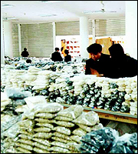
External Economies Before Trade
Example: The button market
In 1980, three brothers in Qiaotou started up a business by picking buttons off the street.
Today, it produces 60% of world’s buttons
External economies of scale in buttons
Read more in The Guardian’s “The tiger's teeth”, 25 May 2005

Slide 46
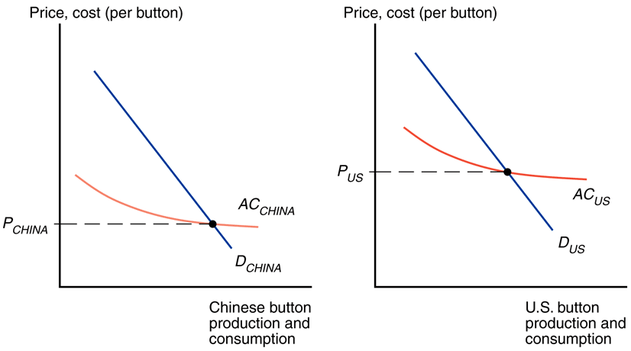
External Economies Before Trade

Slide 47
External Economies Before Trade
Average cost

Slide 48
External Economies Before Trade
Average cost
forward-falling supply curve

Slide 49
External Economies Before Trade
The price is lower in China

Slide 50
External Economies and International Trade
What happens when the countries open up trade in buttons?
China’s buttons are cheaper ➔ The Chinese button industry will expand, while the US button industry will contract.
This process feeds on itself: In the end, all button production will be in China.

Slide 51
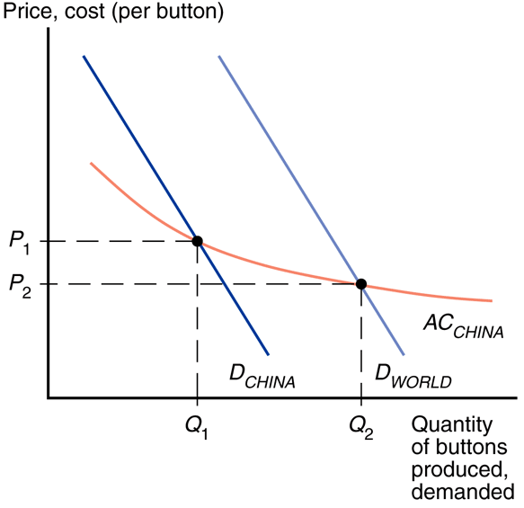
Trade and Prices

Slide 52
Trade and Prices
increased production as a result of trade leads to a button price that is lower than the price before trade

Slide 53
Trade and Prices
increased production as a result of trade leads to a button price that is lower than the price before trade
Trade leads to prices that are lower than the prices in either country before trade!

Slide 54
External Economies and International Trade
In the previous trade models relative prices converge as a result of trade.
If cloth is relatively cheap in the home country and relatively expensive in the foreign country before trade opens, the effect of trade was to raise cloth prices in Home and reduce them in Foreign.
With external economies, by contrast, the effect of trade is to reduce prices everywhere.

Slide 55
External Economies and International Trade
What might cause one country to have an initial advantage from having a lower price?
One possibility is comparative advantage due to underlying differences in technology and resources.
But it can also be historical accidents: Countries that start as large producers in certain industries tend to remain large producers even if another country could potentially produce more cheaply.

Slide 56
External Economies and International Trade
Historical accidents
A tufted blanket, crafted as a wedding gift by a 19th-century teenager, gave rise to the cluster of carpet manufacturers around Dalton, Georgia.
Silicon Valley may owe its existence to two Stanford graduates named Hewlett and Packard who started a business in a garage there.
This suggests that production may not always end up in the ideal location

Slide 57
The Importance of Established Advantage
Assume that the Vietnamese cost curve lies below the Chinese curve because Vietnamese wages are lower than Chinese wages.
At any given level of production, Vietnam could manufacture buttons more cheaply than China.

Slide 58
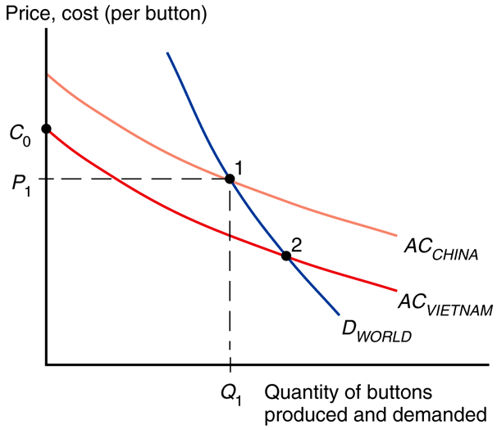
The Importance of Established Advantage
At any given level of production, Vietnam could manufacture buttons more cheaply than China.

Slide 59
The Importance of Established Advantage
One might hope that this would always imply that Vietnam will in fact supply the world market.
But this need not always be the case if China has enough of a head start

Slide 60
The Importance of Established Advantage
Point 2 would be the ideal location

Slide 61
The Importance of Established Advantage
Yet in reality China produces the buttons
Point 2 would be the ideal location

Slide 62
The Importance of Established Advantage
Yet in reality China produces the buttons
Point 2 would be the ideal location
At the current price, Vietnam could not start production at a lower cost

Slide 63
The Importance of Established Advantage
No guarantee that the right country will produce a good that is subject to external economies.

Slide 64
External Economies and Losses from Trade
Trade based on external economies has an ambiguous effect on national welfare.
There will be gains to the world economy by concentrating production of industries with external economies.
It’s possible that a country is worse off with trade than it would have been without trade

Slide 65
External Economies and Losses from Trade
Imagine Thailand could make watches more cheaply, but Switzerland got there first.
The price of watches could be lower in Thailand with no trade.

Slide 66
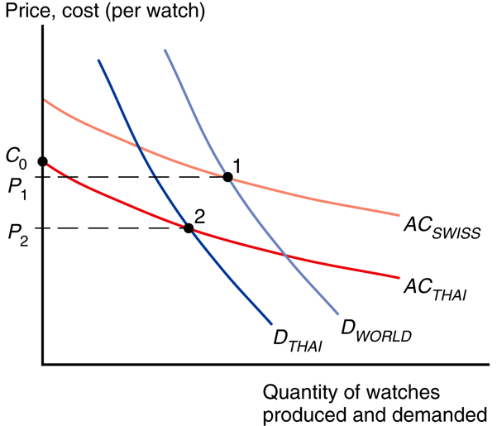
External Economies and Losses from Trade

Slide 67
External Economies and Losses from Trade
Thais buy Swiss watches at price P₁

Slide 68
External Economies and Losses from Trade
For the world, the best would be for Thailand to produce watches and export them

Slide 69
External Economies and Losses from Trade
Even without trade, Thais would be better off by buying Thai watches at price P₂

Slide 70
External Economies and Losses from Trade
Overall, it’s better for the world that each industry with external economies be concentrated somewhere.
In the watch case, it’d be better if they were produced in Thailand
But due to a historical accident, they are produced in Switzerland

Slide 71
Dynamic Increasing Returns
Trade makes Thailand worse off, creating an incentive to protect its potential watch industry from foreign competition.
Should Thailand protect its watch industry?

Slide 72
Dynamic Increasing Returns
Maybe there is an argument for Thailand to start producing watches, or Vietnam buttons
External economies may depend on the amount of cumulative output over time.
Dynamic increasing returns to scale exist if average costs fall as cumulative output over time rises.
It’s not how big the industry, it’s how long it’s been producing !

Slide 73
Dynamic Increasing Returns
Dynamic increasing returns to scale could arise if the cost of production depends on the accumulation of knowledge and experience
A graphical representation of dynamic increasing returns to scale is called a learning curve.

Slide 74
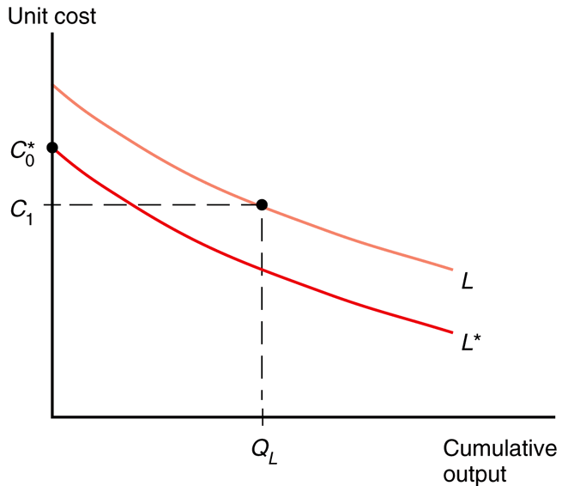
The Learning Curve

Slide 75
The Learning Curve
Home and Foreign

Slide 76
The Learning Curve
Home and Foreign
Home has experience. It’s produced Q_{L}

Slide 77
The Learning Curve
Home and Foreign
Home has experience. It’s produced Q_{L}

Slide 78
The Learning Curve
Foreign has no experience. Its unit cost is higher than Home’s despite its lower wages
Home and Foreign
Home has experience. It’s produced Q_{L}

Slide 79
Dynamic Increasing Returns
Like external economies of scale at a point in time, dynamic increasing returns to scale can lock in an initial advantage or a head start in an industry.
They can be used to justify protectionism.
Temporary protection of industries enables them to gain experience: infant industry argument.
But temporary is often for a long time, and it is hard to identify when external economies of scale really exist.

Slide 80
Infant industry argument
Consider two countries: US and Brazil and the airplane industry

Slide 81
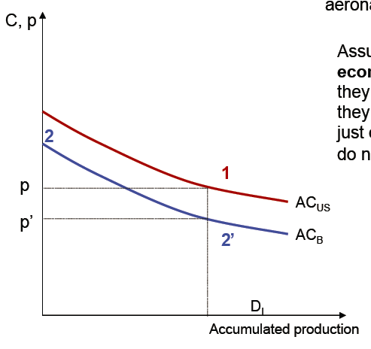
Infant industry argument
Consider two countries: US and Brazil and the airplane industry

Slide 82
Infant industry argument
Consider two countries: US and Brazil and the airplane industry
If the US and Brazil had produced the same accumulated quantity (had the same experience), Brazil would be the most efficient producer

Slide 83
Infant industry argument
Since Brazil is at Point 2, Brazilian producers do not have any incentive to produce

Slide 84
Infant industry argument
Brazil can use protectionist measures (a tariff larger than the cost difference) or subsidies (which cover at least the cost difference) to incentivize the creation of a local industry.
Once Brazil has learned, it would attain a cost lower than the US. At that point, Brazil can then open up to trade and become the world producer.

Slide 85
Infant industry argument
This policy has short-run costs (protectionist phase) as well as long-run benefits (once Brazil becomes the most efficient producer).
The policy can be justified if the long-run gains more than compensate for the short-run losses.

Slide 86
Infant industry argument
These policies often fail because the local industry never becomes more efficient than the foreign competition. Why?
Politicians do not have enough information to know whether the average cost curve of their country is really below that of the foreign competition (all countries like to think that they can have a Silicon Valley).
Protectionism does not incentivize local producers to improve productivity
Local producers will lobby their government to keep protectionist measures indefinitely

Slide 87
Infant industry argument
Both the US and Brazil want to “host” the aeroplane industry
And so does Europe…and Canada…
They all subsidize their local industry, i.e. Boeing, Airbus, Embraer and Bombardier
This creates “trade conflicts” between countries

Slide 88
Economic Geography
External economies may also be important for interregional trade within a country.
Many movie producers located in Los Angeles produce movies for consumers throughout the US
Many financial firms located in New York provide financial services for consumers throughout the US

Slide 89
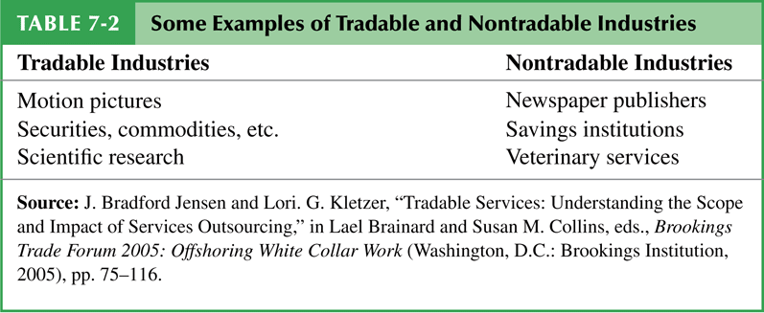
Economic Geography
Specialization of regions doesn’t happen in all goods as some, like haircuts, must usually be supplied locally.

Slide 90
Economic Geography
Economic geography refers to the study of international trade, interregional trade and the organization of economic activity in metropolitan and rural areas.

Slide 91
Recap
Mutually beneficial trade can arise as a result of economies of scale.
With trade, a country can take advantage of economies of scale to produce more efficiently than if it tried to produce everything for itself.
International trade allows each country to specialize without sacrificing variety in consumption.

Slide 92
Recap
Trade need not be the result of comparative advantage. It can result from economies of scale
External economies give an important role to history and accident in determining the pattern of international trade
When external economies are important, countries can conceivably lose from trade

