Slide 1
Specific Factors and Income Distribution
Pierre-Louis Vézina
p.vezina@bham.ac.uk

Slide 2
Specific Factors and Income Distribution
Two main reasons why international trade has strong effects on the distribution of income within a country:
  Industries differ in the factors of production they use (Stolper-Samuelson)
  Factors cannot move immediately or costlessly from one industry to another

Slide 3
Specific Factors and Income Distribution
Two main reasons why international trade has strong effects on the distribution of income within a country:
  Industries differ in the factors of production they use (Stolper-Samuelson)
  Factors cannot move immediately or costlessly from one industry to another
    ➔ Specific factors

Slide 4
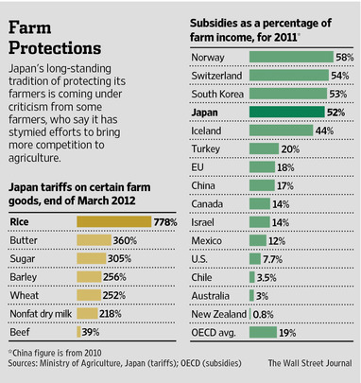
The example of Japan’s farmers
Japan’s rice policy allows very little rice to be imported
To export $100 of rice to Japan you must pay $778 in tariff duties!
Scarce land means rice is much more expensive to produce in Japan than in other countries

Slide 5

The example of Japan’s farmers
Little question Japan as a whole would be better off by importing rice
But Japanese farmers would be hurt

Slide 6

The example of Japan’s farmers
The farmers could move to the Toyota factory
But changing jobs and cities is costly and inconvenient
  The special skills they developed would be useless at the Factory
  (I’ve worked in this field all my life, and so did my ancestors before me!)

Slide 7
The example of Japan’s farmers
In the short-run, farmers cannot move to the Toyota factory
  Their skills are specific to the rice fields

Slide 8
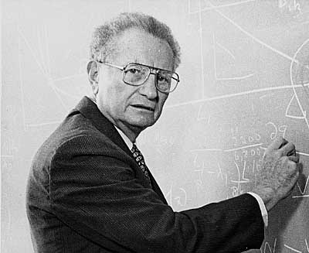

Specific factor model
Paul Samuelson (again!) and Ronald Jones

Slide 9

Specific factor model
What is a specific factor?
  Specific labour: A farmer, a car-factory worker?

Slide 10

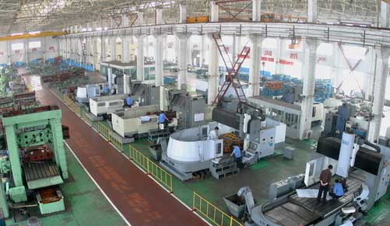
Specific factor model
Vats to brew beer
Stamping presses to build auto bodies

Slide 11
Specific factor model
Both vats and stamping presses can be thought of as specific capital
In the short-run, you can’t use your vats to produce cars
  Vats are specific to beer
  Presses are specific to cars

Slide 12
Specific factor model
Assumptions:
  Two goods, cloth and food.
  Three factors of production
    labour (L)
    capital (K)
    land (T for terrain)
  Perfect competition

Slide 13
Specific factor model
Cloth produced using capital and labour (but not land)
  Q_{C} = Q_{C} (K, L_{C})
Food produced using land and labour (but not capital)
  Q_{F} = Q_{F} (T, L_{F})

Slide 14
Specific factor model
Labour is a mobile factor that can move between sectors
  (Farmers can go work at Toyota)
Land and capital are both specific factors used only in the production of one good

Slide 15
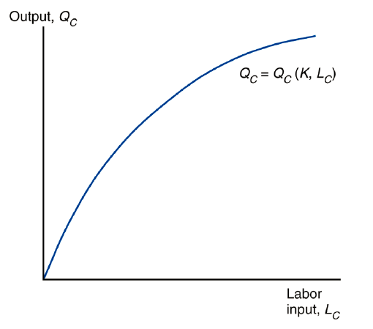
Specific factor model
Cloth production function

Slide 16
Specific factor model
Cloth production function
The shape of the function reflects diminishing returns

Slide 17

Specific factor model
Adding one worker (without increasing the amount of capital) means that each worker has less capital to work with
Each additional worker adds less output than the last

Slide 18
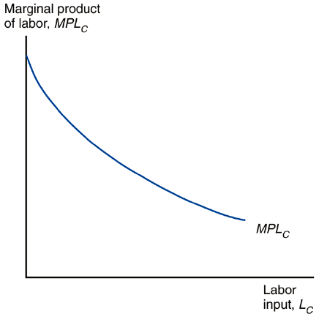
Specific factor model
The marginal product of labour is the slope of the production function

Slide 19
Specific factor model
It gives the increase in output that corresponds to an extra unit of labour
The marginal product of labour is the slope of the production function

Slide 20
Specific factor model
It gives the increase in output that corresponds to an extra unit of labour
Remember when we studied the Stolper-Samuelson theorem, we assumed the marginal productivity of labour decreased with L/K. That’s why!
The marginal product of labour is the slope of the production function

Slide 21
Specific factor model
How does the economy’s mix of output change as labour is shifted from one sector to the other?
For the economy as a whole, the total labour employed in cloth and food must equal the total labour supply: L_{C} + L_{F} = L
We have 2 productions functions (Cloth and Food) and a labour constraint
  Let’s draw a PPF

Slide 22
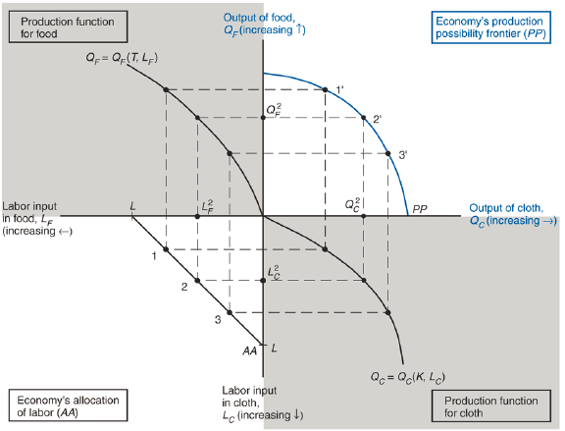

Slide 23
Specific factor model
Why is the production possibilities frontier curved?
  The slope is MPL_{F}/MPL_{C}

Slide 25
  The slope is MPL_{F}

Slide 26
  The slope is MPL_{F}
  The slope is MPL_{C}

Slide 27
  The slope is MPL_{F} / MPL_{C}
  The slope is MPL_{F}
  The slope is MPL_{C}

Slide 28
Specific factor model
Opportunity cost of cloth in terms of food is the slope of the PPF
  Opportunity cost of producing one more cloth is MPL_{F}/MPL_{C} of food
The slope becomes steeper as an economy produces more cloth
  Opportunity cost rises with production

Slide 29

Specific factor model
How much labour is employed in each sector?

Slide 30
  At which point am I on this line?

Slide 31
Specific factor model
Need to look at supply and demand in the labour market
In each sector, employers will maximize profits by demanding labour up to the point where the value produced by an additional hour equals the marginal cost of employing a worker for that hour

Slide 32
Specific factor model
Need to look at supply and demand in the labour market
In each sector, employers will maximize profits by demanding labour up to the point where the value produced by an additional hour equals the marginal cost of employing a worker for that hour
  You wouldn’t hire a worker if the value of his production was less than his wage

Slide 33
Specific factor model
The demand curve for labour in the cloth sector:
  MPL_{C} x P_{C} = w

Slide 34
Specific factor model
The demand curve for labour in the cloth sector:
  MPL_{C} x P_{C} = w
His wage

Slide 35
Specific factor model
The demand curve for labour in the cloth sector:
  MPL_{C} x P_{C} = w
His wage
The value of his production

Slide 36
Specific factor model
The demand curve for labour in the cloth sector:
  MPL_{C} x P_{C} = w
His wage
The value of his production
The wage equals the value of the marginal product of labour in cloth manufacturing

Slide 37
Specific factor model
The demand curve for labour in the food sector: MPL_{F} x P _{F} = w

Slide 38
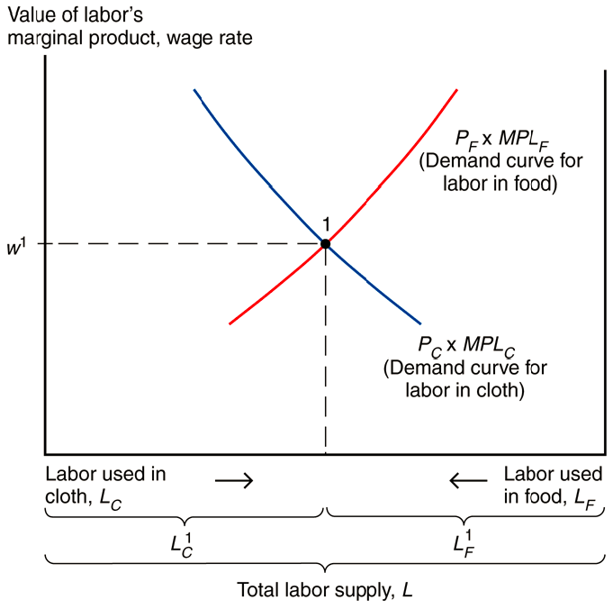

Slide 39
The two sectors must pay the same wage because labour can move between sectors

Slide 40
Where the labour demand curves intersect gives the equilibrium wage and allocation of labour between the two sectors
The two sectors must pay the same wage because labour can move between sectors

Slide 41
Specific factor model
At production (point 1) we have
  w = MPL_{C} × P_{C} = MPL_{F} × P_{F}
Rearranging we have:
  -MPL_{F}/MPL_{C} = -P_{C}/P_{F}

Slide 42
Specific factor model
At production (point 1) we have
  w = MPL_{C} × P_{C} = MPL_{F} × P_{F}
Rearranging we have:
  -MPL_{F}/MPL_{C} = -P_{C}/P_{F}
  The slope of the production possibility frontier

Slide 43
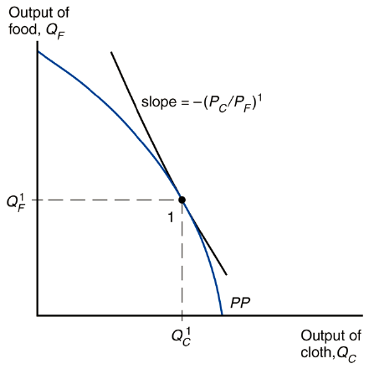
Specific factor model

Slide 44
Specific factor model
The slope of the production possibility frontier must be tangent to a line whose slope is minus the price of cloth divided by that of food

Slide 45
Specific factor model
The slope of the production possibility frontier must be tangent to a line whose slope is minus the price of cloth divided by that of food
This gives us a relationship between relative prices and output mix

Slide 46
Specific factor model
What happens to the allocation of labour and the distribution of income when the prices of food and cloth change?
  Let’s say P_{C} increases by 7%

Slide 47
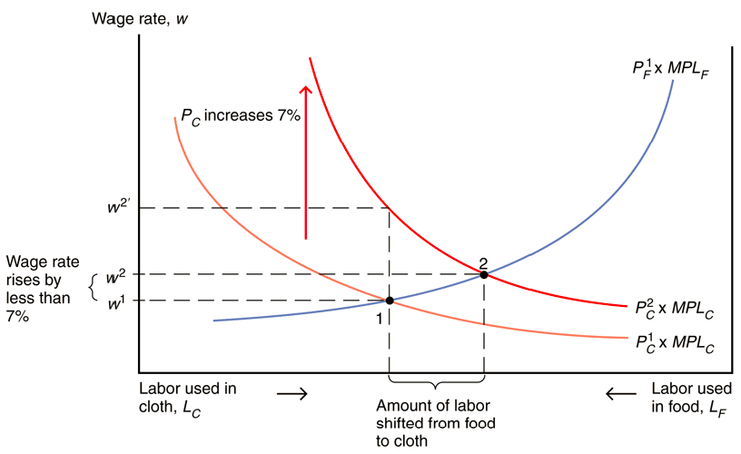
Specific factor model

Slide 48
Specific factor model
The demand for labour increases in the cloth sector

Slide 49
Specific factor model
The demand for labour increases in the cloth sector
Labour shifts from the food sector to the cloth sector

Slide 50
Specific factor model
The demand for labour increases in the cloth sector
Labour shifts from the food sector to the cloth sector
The wage rate (w) does not rise as much as P_{C} since cloth employment increases and thus the marginal product of labour in that sector falls

Slide 51
Specific factor model
The demand for labour increases in the cloth sector
Labour shifts from the food sector to the cloth sector
The wage rate (w) does not rise as much as P_{C} since cloth employment increases and thus the marginal product of labour in that sector falls

Slide 52
Specific factor model
The demand for labour increases in the cloth sector
Labour shifts from the food sector to the cloth sector
This is how prices affect wages! Remember Stolper-Samuelson
The wage rate (w) does not rise as much as P_{C} since cloth employment increases and thus the marginal product of labour in that sector falls

Slide 53
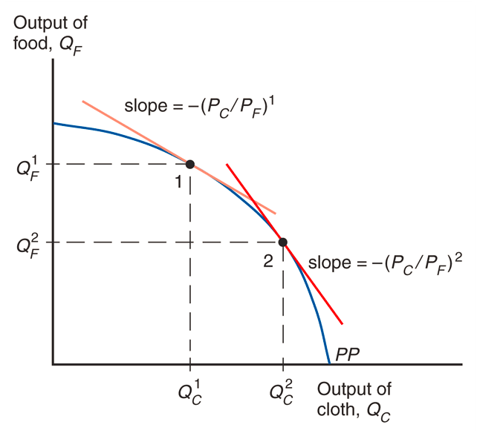
Specific factor model

Slide 54
International Trade
Opening up to trade increases the relative price of cloth in an economy whose relative supply of cloth is larger than for the world as a whole

Slide 55
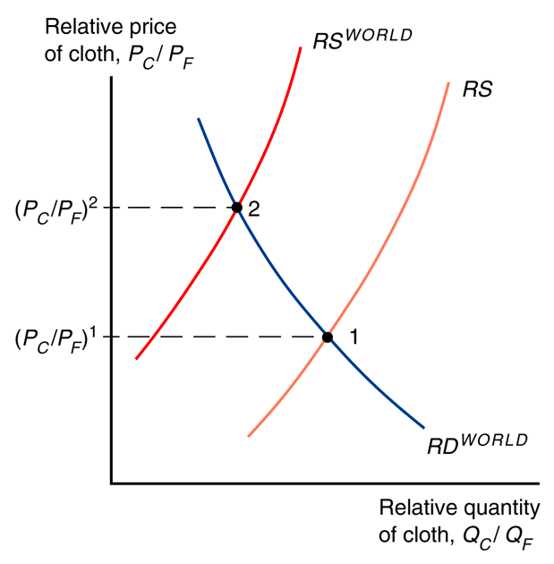

Slide 56
The differences in RS and RS^{WORLD} can be due to technology or resource differences

Slide 57
International Trade
Without trade, the economy’s output of a good must equal its consumption
International trade allows the mix of cloth and food consumed to differ from the mix produced
The country cannot spend more than it earns: P_{C} D_{C} + P_{F} D_{F} = P_{C} Q_{C} +P_{F} Q_{F}

Slide 58
International Trade
Without trade, the economy’s output of a good must equal its consumption
International trade allows the mix of cloth and food consumed to differ from the mix produced
The country cannot spend more than it earns: P_{C} D_{C} + P_{F} D_{F} = P_{C} Q_{C} +P_{F} Q_{F}
Value of consumption
Value of production

Slide 59
International Trade
Rearranging, we get:
D_{F} - Q_{F} = (P_{C} / P_{F}) (Q_{C} – D_{C})

Slide 60
International Trade
Rearranging, we get:
D_{F} - Q_{F} = (P_{C} / P_{F}) (Q_{C} – D_{C})
Food imports
Cloth exports

Slide 61
International Trade
Rearranging, we get:
D_{F} - Q_{F} = (P_{C} / P_{F}) (Q_{C} – D_{C})
An economy can import an amount of food equal to the relative price of cloth times the amount of cloth exported
Food imports
Cloth exports

Slide 62
International Trade
Rearranging, we get:
D_{F} - Q_{F} = (P_{C} / P_{F}) (Q_{C} – D_{C})
An economy can import an amount of food equal to the relative price of cloth times the amount of cloth exported
Food imports
Cloth exports
What you import is limited by your exports
This is your budget constraint

Slide 63
International Trade
Rearranging, we get:
D_{F} - Q_{F} = (P_{C} / P_{F}) (Q_{C} – D_{C})
An economy can import an amount of food equal to the relative price of cloth times the amount of cloth exported
Food imports
Cloth exports
What you import is limited by your exports
This is your budget constraint

Slide 64
International Trade
Rearranging, we get:
D_{F} - Q_{F} = (P_{C} / P_{F}) (Q_{C} – D_{C})
An economy can import an amount of food equal to the relative price of cloth times the amount of cloth exported
Food imports
Cloth exports
What you import is limited by your exports
This is your budget constraint
You can consume anything you want within your budget constraint

Slide 65
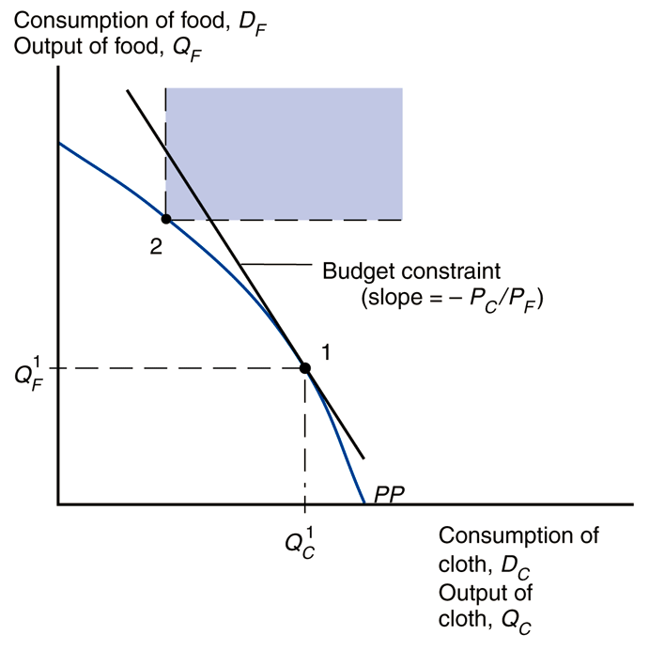

Slide 66
Gains from Trade
The economy can consume more of both goods if it consumes along the PPF in the blue zone

Slide 67
Gains from Trade
The economy can consume more of both goods if it consumes along the PPF in the blue zone
The economy is able to afford amounts of cloth and food that the country is not able to produce itself

Slide 68
Trade and the Distribution of Income
Suppose that with trade P_{C} increases by 7%. Then, the wage would rise by less than 7%
What is the economic effect of this price increase on the incomes of the following three groups?
  workers
  owners of capital
  owners of land

Slide 69
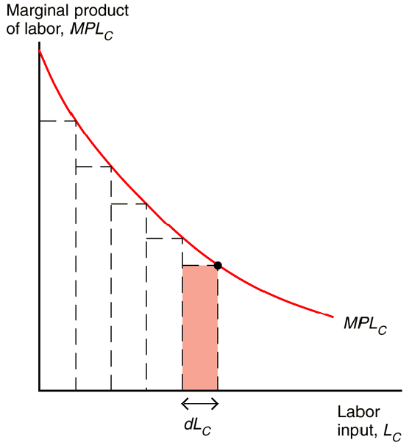
Output Is Equal to the Area Under the Marginal Product Curve

Slide 70
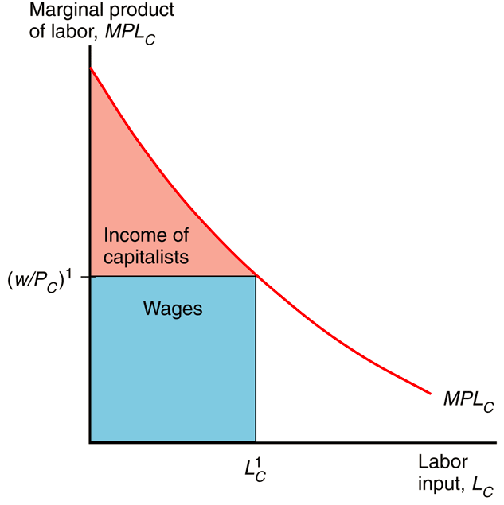
The Distribution of Income Within the Cloth Sector

Slide 71
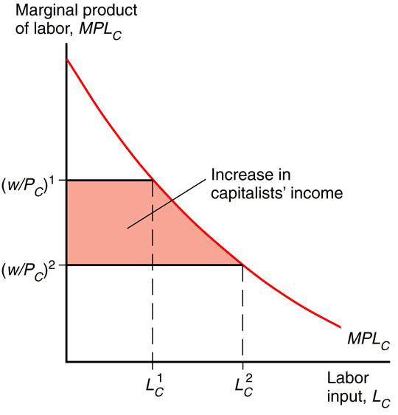
A Rise in P_{C} Benefits the Owners of Capital

Slide 72
A Rise in P_{C} Benefits the Owners of Capital
P_{C} rises more than w, so
w/ P_{C} falls

Slide 73
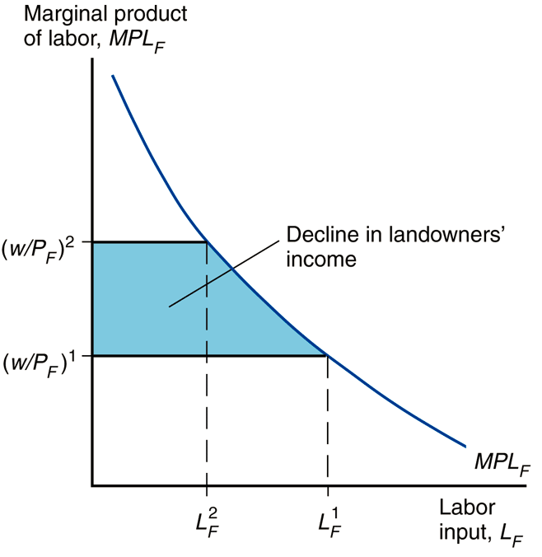
A Rise in P_{C} Hurts Landowners
w rise, so
w/ P_{F} rises

Slide 74
Announcement
Test on Monday 8 Dec!
No lecture on Friday 12 Dec!

Slide 75
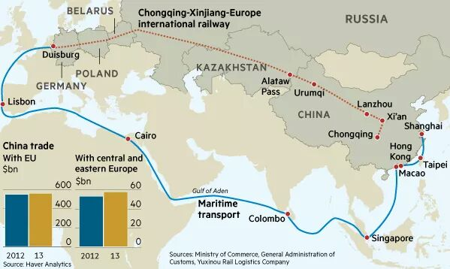
World trade fact of the week
Financial Times, 17 Oct 2014, Geopolitics cast shadow over New Silk Road
Notes:
Door to door, the journey from China to Duisburg for HP’s products takes an average 22 days by train, or half what it can by sea, and costs just 20-25 per cent more, Mr Kleijwegt says

Slide 76
Trade and the Distribution of Income
Owners of capital are definitely better off
Landowners are definitely worse off
We cannot say whether workers are better or worse off:
  Depends on the relative importance of cloth and food in workers’ consumption (w/ P_{C} falls but w/ P_{F} rises)

Slide 77
Trade and the Distribution of Income
Trade benefits the factor that is specific to the export sector (whose relative price rises), but hurts the factor that is specific to the import-competing sectors
  Owners of land lose if Japan opens up to rice imports
Trade has ambiguous effects on mobile factors, i.e. workers
  Wages will go up but so will the price of cars

Slide 78
Trade and the Distribution of Income
Trade benefits a country by expanding choices
Economists support free trade as it is possible to redistribute income so that everyone gains from trade
Those who gain from trade could compensate those who lose and still be better off themselves
  The government could tax Toyota by giving free cars to landowners. That would compensate them for their income loss

Slide 79
Trade and unemployment
Trade shifts jobs from import-competing to export sectors
Process not instantaneous – some workers will be unemployed as they look for new jobs

Slide 80
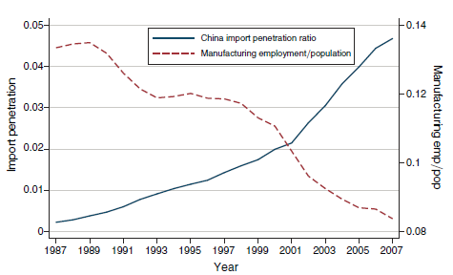
Trade and unemployment
If workers are sector-specific, they lose from trade if in the importing sector

Slide 81
Trade and unemployment
How much unemployment can be traced back to trade?
  From 1996 to 2008, only about 2.5% of involuntary displacements stemmed from import competition or plants moved overseas

Slide 82
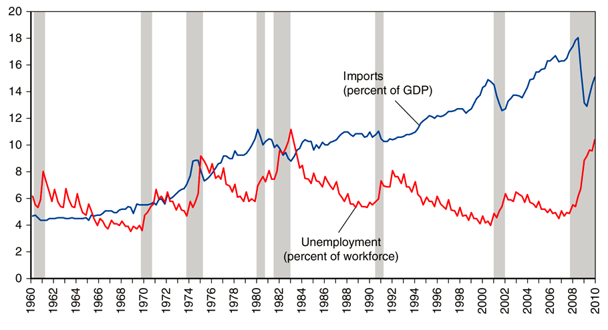
Trade and unemployment

Slide 83
Trade and unemployment
Governments usually provide a “safety net” of income support to cushion the losses to groups hurt by trade (or other changes)

Slide 84
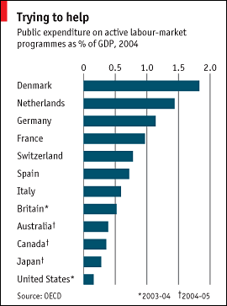
Trade and unemployment

Slide 85
RECAP
3 models of trade:
  Ricardo helps us understand why countries gain from trade
  Specific factors help us understand why trade creates winners and losers in the short run
  Hecksher-Ohlin helps us understand the pattern of trade, why countries only partly specialise and why, even in the long run, some factors lose from trade

Slide 86
Who is against free trade?
Trade creates winners and losers
Does this explain why some people and countries are more protectionist than others?

Slide 87


Who is against free trade?
Anna Maria Mayda & Dani Rodrik
"Why are some people (and countries) more protectionist than others?," 2005 European Economic Review

Slide 88
Who is against free trade?
World Values Survey:
  “Do you think it is better if: (1) Goods made in other countries can be imported and sold here if people want to buy them; or that: (2) There should be stricter limits on selling foreign goods here, to protect the jobs of people in this country; or: (9) Don’t Know.”

Slide 89
Who is against free trade?
World Values Survey (2002):
  60% of respondents are anti free trade
A 2006 poll of PhD members of the American Economic Association:
  12% of economists are anti free trade

Slide 90
Why are some people (and countries) more protectionist than others?
Prediction of the factor-specific model:
  Workers cannot move across sectors
  Workers in comparative-disadvantage sectors lose from globalization as they lose their job or suffer form income losses as prices go down in their sectors

Slide 91
Why are some people (and countries) more protectionist than others?
Prediction of the Heckscher-Ohlin model:
  Costless inter-sector mobility of workers
  Here trade benefits individuals who own the factors with which the economy is relatively well endowed and hurts the others. This is the Stolper-Samuelson theorem.

Slide 92
Why are some people (and countries) more protectionist than others?
According to the HO model, in countries relatively well-endowed with skilled labour, more-skilled workers should support freer trade
According to the specific-factor model, workers employed in comparative–advantage sectors should support freer trade

Slide 93
Why are some people (and countries) more protectionist than others?
They find that individuals employed in import competing industries are more likely to favor trade restrictions
  ➔ As the specific factor model predicted

Slide 94
Why are some people (and countries) more protectionist than others?
  They find that higher education people oppose trade restrictions, but only in countries that are well endowed with high-skilled human capital measured by GDP per capita)

Slide 95
Why are some people (and countries) more protectionist than others?
Impact of education on being pro free trade

Slide 96
Why are some people (and countries) more protectionist than others?
By showing that the impact of education (skills) on trade preferences was dependent on GDP, they rule out that better educated people prefer more trade simply because they have a better understanding of comparative advantage

Slide 97
Who is against free trade?

Slide 98

Who is against free trade?
Why doesn’t everyone get the case for free trade?

Slide 99
The Political Economy of Trade Policy
Trade produces losers as well as winners
Does this explain trade protection?

Slide 100
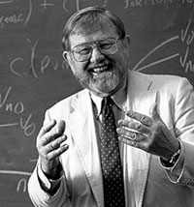
The Political Economy of Trade Policy
Typically, those who gain from trade are a much less concentrated, informed, and organized group than those who lose
Mancur Olson: Concentrated minor interests will be overrepresented and diffuse majority interests trumped

Slide 101
The Political Economy of Trade Policy
Typically, those who gain from trade are a much less concentrated, informed, and organized group than those who lose
Mancur Olson: Concentrated minor interests will be overrepresented and diffuse majority interests trumped
  This can explain import tariffs on rice in Japan

Slide 102
The Political Economy of Trade Policy
Another good example is the US sugar industry
  US has been limiting imports of sugar for many years using import quotas
  As a result, sugar is twice as expensive in the US

Slide 103
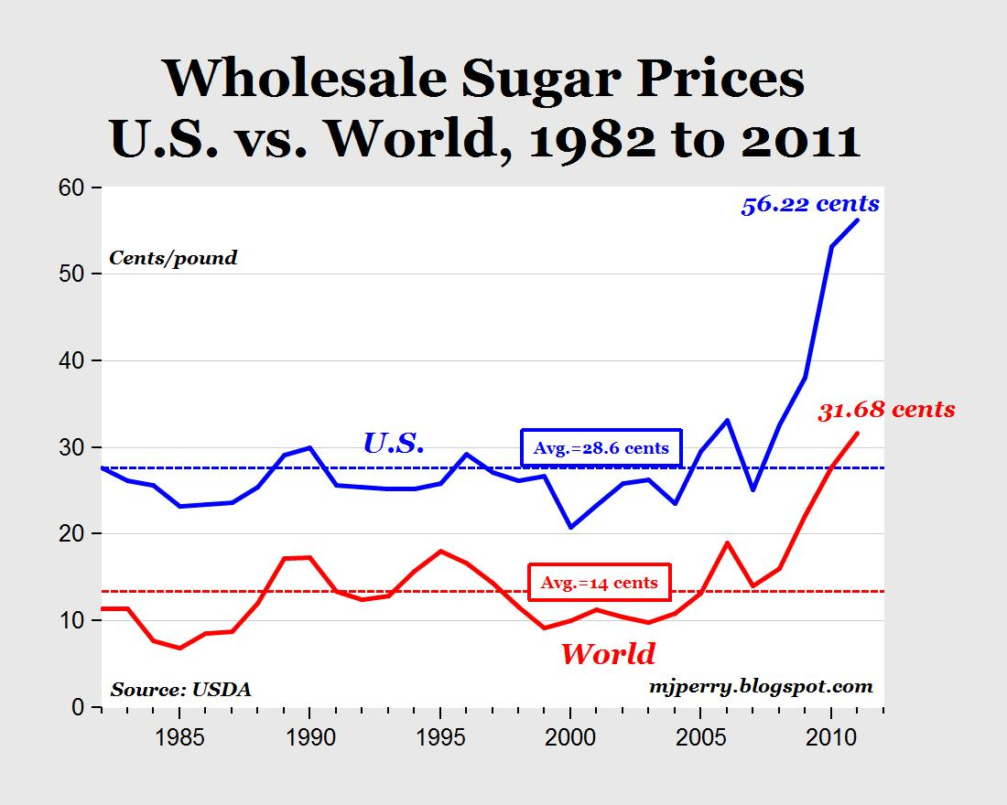
The Political Economy of Trade Policy

Slide 104
The Political Economy of Trade Policy
The cost to consumers of this higher price amounts to $2 billion a year
The gains to the sugar industry are probably less than half of that
So why does the government restrict sugar imports?

Slide 105

The Political Economy of Trade Policy
Each consumer suffers very little, and the costs are spread across cupcakes and milkshakes
Consumers don’t even know about the import quotas

Slide 106
The Political Economy of Trade Policy
Sugar producers on the other hand know they get higher profits thanks to the quotas
And the profits are quite concentrated
  Only 17 farms generate more than 50% of the sugar industry’s profits
Those producers are organized in associations that make large campaign contributions

Slide 107
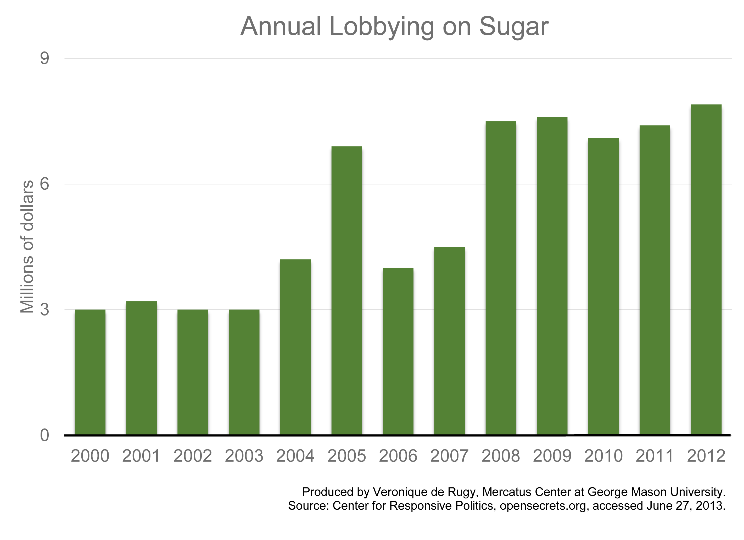

Slide 108
The Political Economy of Trade Policy
Trade restrictions do protect jobs, but at a cost of $826,000 a job per year
And some candy companies that need sugar as inputs move to Canada, where sugar prices are lower, thus destroying jobs in the US

Slide 109
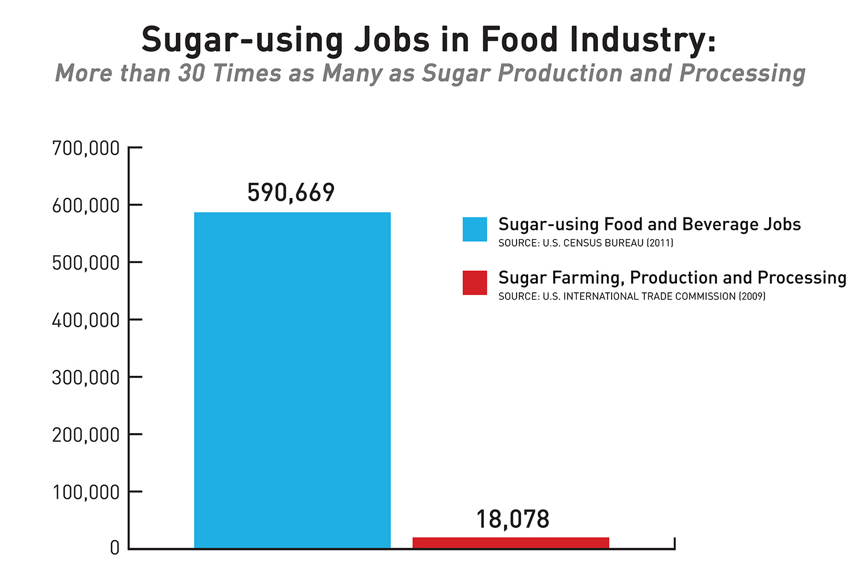
The Political Economy of Trade Policy

Slide 110
International labour mobility
Why does labour migrate and what effects does labour migration cause?
The specific-factor model can also help us answer this question!

Slide 111
Remember this graph?

Slide 112
International labour mobility
Consider movement of labour across countries instead of across sectors
  (Think of food as Foreign and cloth as Home)

Slide 113
International labour mobility
Let’s say the 2 countries produce only food and it is not traded
To produce food, you need two factors of production, land and labour:
  Land cannot move across countries but labour can

Slide 114
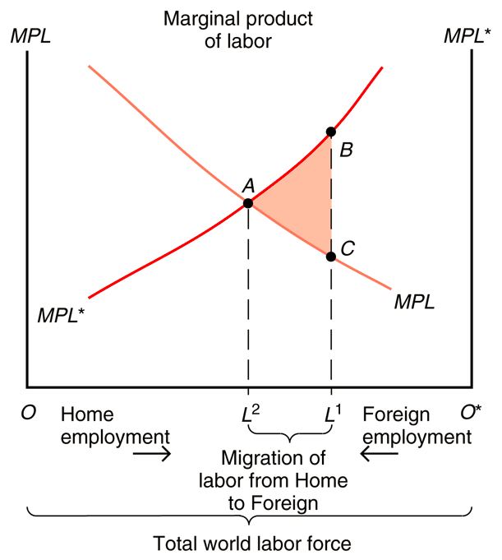

Slide 115
  MPLs give us real wages (w/p)

Slide 116
  MPLs give us real wages (w/p)
Let’s assume we are initially at L¹

Slide 117
  MPLs give us real wages (w/p)
Let’s assume we are initially at L¹
Given this international division of labour, real wages are higher in Foreign (B) than at home (C)

Slide 118
  MPLs give us real wages (w/p)
Let’s assume we are initially at L¹
Given this international division of labour, real wages are higher in Foreign (B) than at home (C)
Lower wage due to less land per worker (lower productivity)

Slide 119
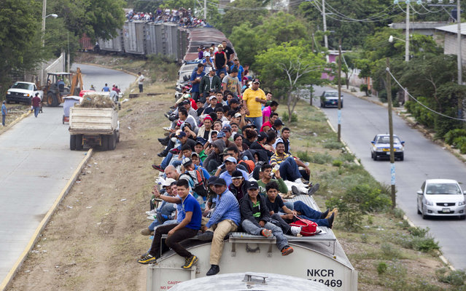
International labour mobility
Workers migrate to wherever wages are highest
➔ workers are moving abroad!

Slide 120
If workers are free to migrate, workers move from Home to Foreign until real wages are equal across countries (point A)

Slide 121
Home workers earn more due to emigration regardless if they migrate or stay home

Slide 122
Home workers earn more due to emigration regardless if they migrate or stay home
Immigration into Foreign increases the supply of labour and Foreign workers now earn less

Slide 123
International labour mobility
Migration increases world output!

Slide 124
  The value of foreign output rises by the area under its MPL* curve from L1 to L2

Slide 125
  The value of foreign output rises by the area under its MPL* curve from L1 to L2
Landowners in Foreign gain

Slide 126
  The value of foreign output rises by the area under its MPL* curve from L1 to L2
  The value of domestic output falls by the area under its MPL curve from L2 to L1

Slide 127
  The value of foreign output rises by the area under its MPL* curve from L1 to L2
  Home landowners lose
  The value of domestic output falls by the area under its MPL curve from L2 to L1

Slide 128
  The value of foreign output rises by the area under its MPL* curve from L1 to L2
  Foreign output increases more than Home decreases!
  The value of domestic output falls by the area under its MPL curve from L2 to L1

Slide 129
That’s because labour moves to where it is more productive
  World output rises!

Slide 130
That’s because labour moves to where it is more productive
  World output rises!
The value of world output is maximized when the marginal productivity of labour is the same across countries

Slide 131
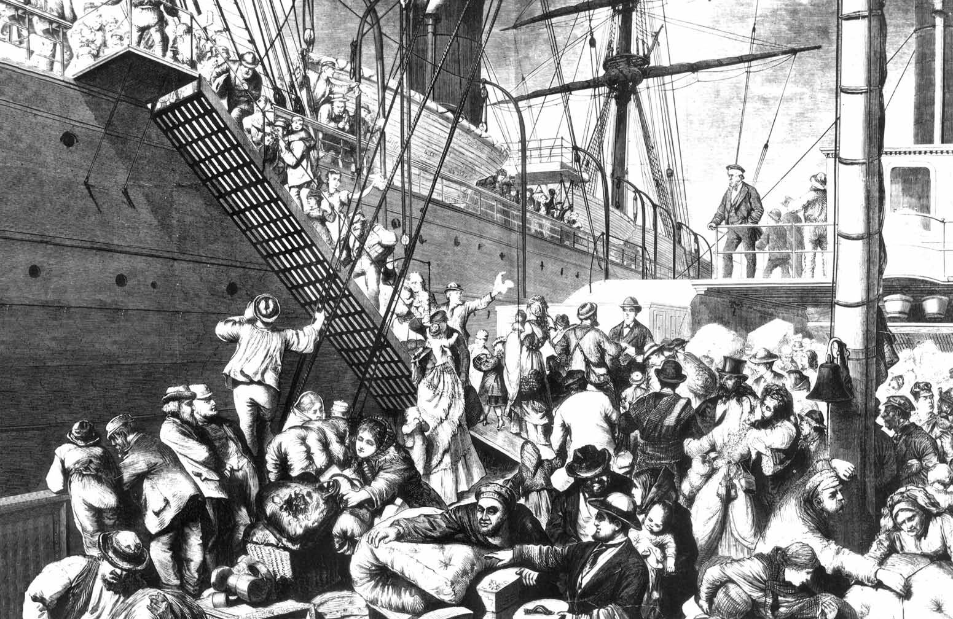
International labour mobility
Does migration lead to the wage changes predicted?
Let’s look at the Age of Mass Migration

Slide 132
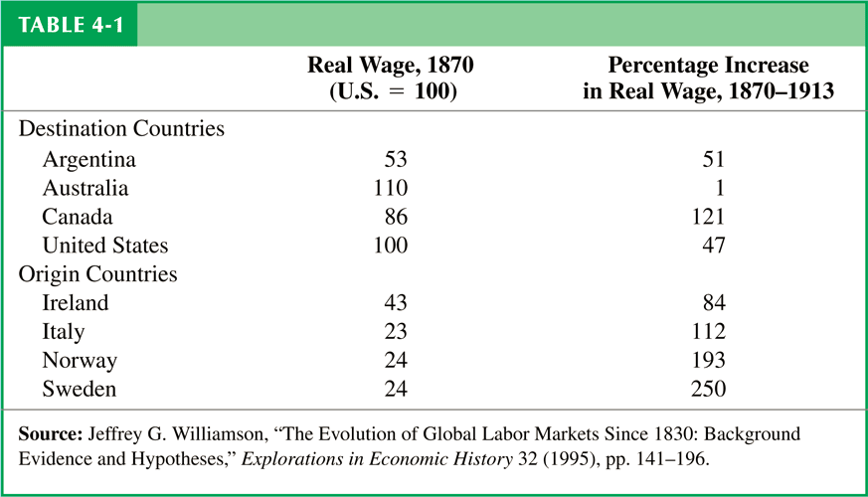
International labour mobility

Slide 133
International labour mobility
  Real wages in 1870 were much higher in destination countries than in origin countries

Slide 134
International labour mobility
  Up until the eve of World War I in 1913, wages rose faster in origin countries than in destination countries (except Canada)
  Migration moved the world toward more equalized wages

Slide 135
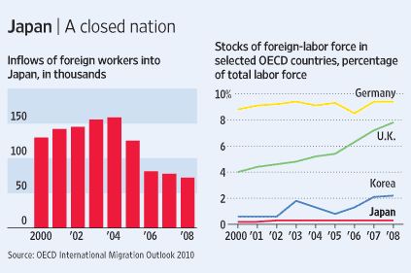
International labour mobility
Nowadays, wages do not actually equalize, due to policies restricting immigration

Slide 136
Recap
International trade often has strong effects on the distribution of income within countries -- produces losers as well as winners.
Income distribution effects arise for two reasons:
  Factors of production cannot move costlessly and quickly from one industry to another
  Changes in an economy’s output mix have differential effects on the demand for different factors of production

