Slide 1
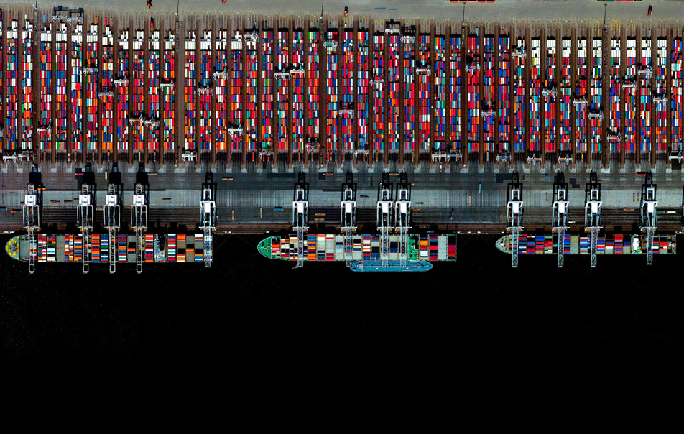
INTRODUCTION TO INTERNATIONAL TRADE
Lecturer: Pierre-Louis Vézina (p.vezina@bham.ac.uk)
Notes:
Port of Rotterdam. Google Earth

Slide 2
This module
10 weeks to understand how countries gain from trade
  Week 1: An overview of world trade
  Week 2-7: Sources of gains from trade
  Week 8-10: Trade policy
Syllabus up on canvas!

Slide 3
Good to know
Book: International Economics, Theory and Policy, Paul Krugman, Maurice Obstfeld, Marc J. Melitz. , 9th Edition, Pearson.
E-copy available from the library
Slides will be uploaded on canvas before the lecture

Slide 4
Good to know
Lectures:
  Monday 5-6pm, , Poynting Building LT (S02)
  Friday 11am-12pm, (Education Building Vaughn Jeffries LT)
Office hours
  Monday 2-4pm
  Friday 1.30-2.30pm,

Slide 5
Good to know
TA for classes: Liyun Zhang
Classes:
  three for each student
  sign up via Canvas

Slide 6
Good to know
Assessment: 80% summer exam, 20% test (Week 9).

Slide 7
Week 1
An overview of world trade
The gravity model
The border effect

Slide 8
An overview of world trade
5 facts about world trade:
  1: Since 1960, world trade has become a much larger part of the world economy

Slide 9
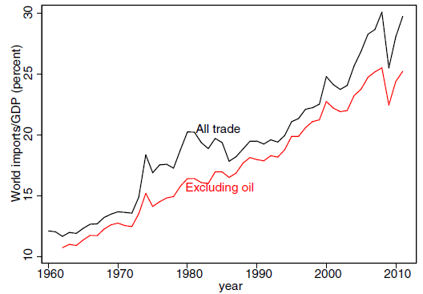

Slide 10
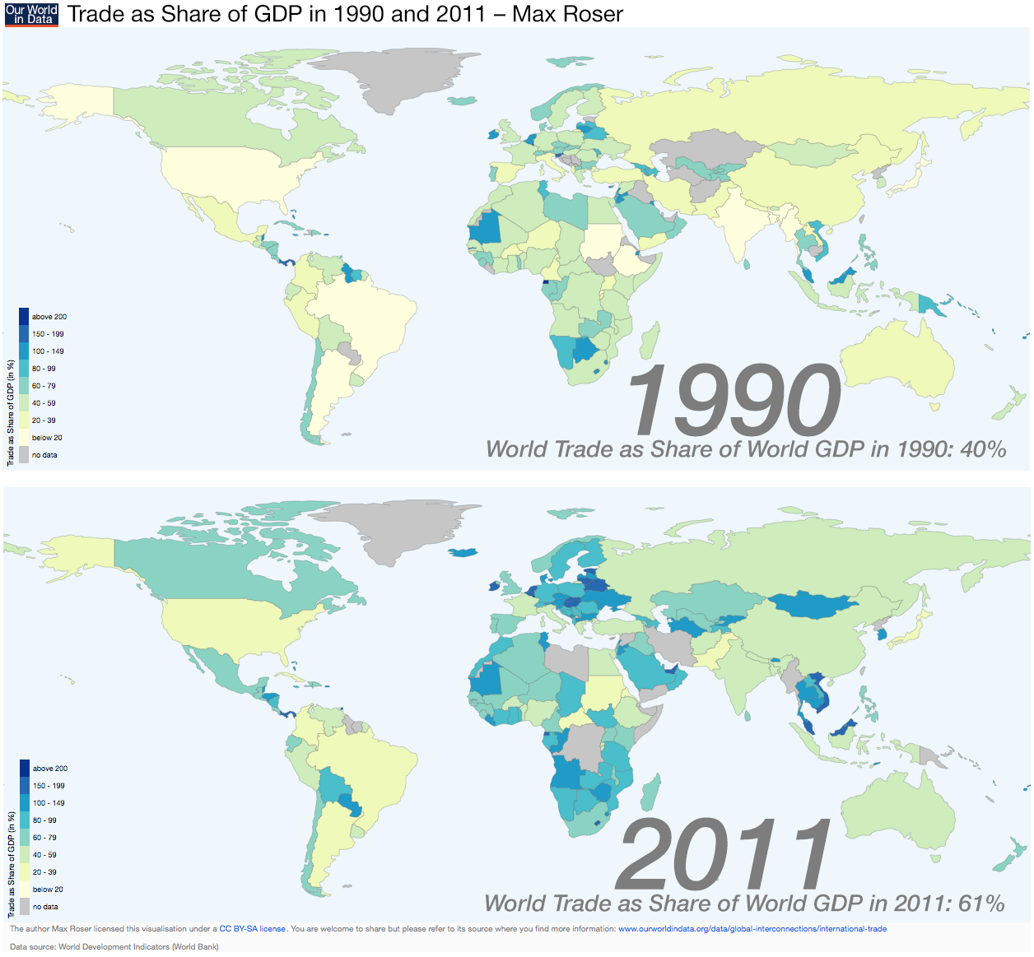

Slide 11
An overview of world trade
5 facts about world trade:
  1: Since 1960, world trade has become a much larger part of the world economy
  2: Almost 60% of trade is manufacturing goods

Slide 12
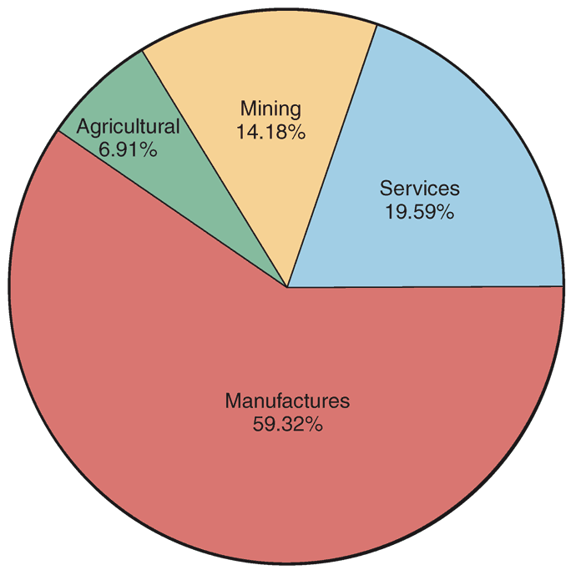
2005 world trade

Slide 13
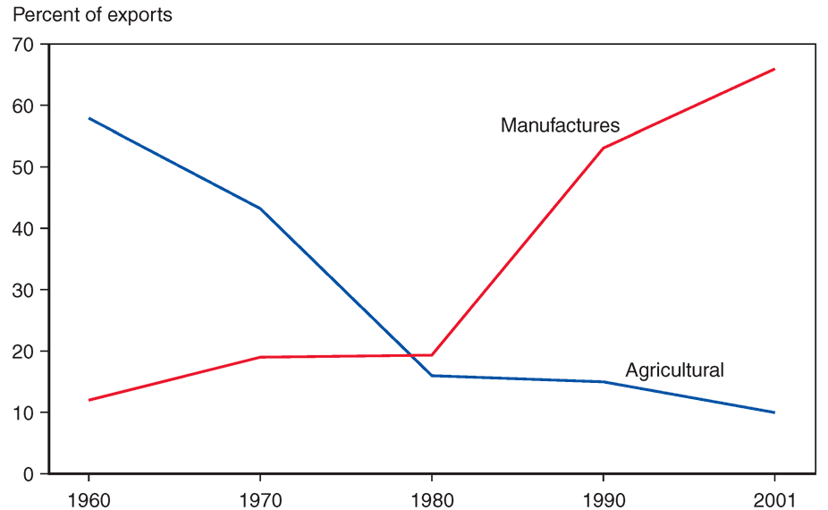
Changing composition of developing-country exports

Slide 14
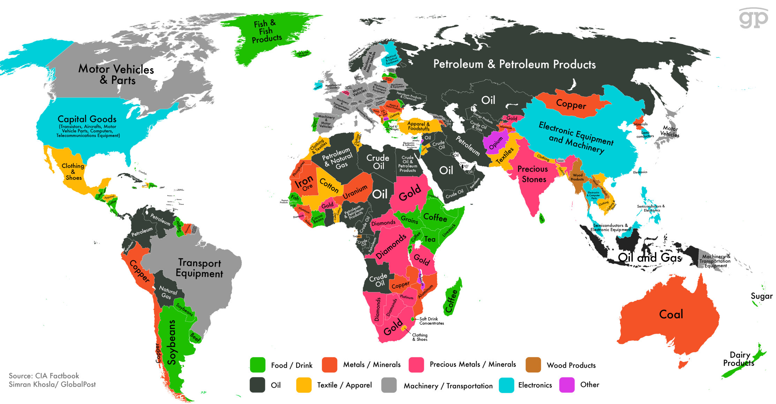
Notes:
Countries that depend on metal or mineral exports are typically quite poor, with the dominance of these sectors generally a tell-tale sign of a lack of any kind of sophisticated industrial base. There are, however, exceptions. Australia enjoys one of the world's highest living standards, notwithstanding a global trade balance driven by coal and other minerals, while copper-oriented Chile is Latin America's richest country. The black-colored oil exporters are an interestingly diverse group. The richest countries in the world — places like Norway and Qatar — fall into this category, but so does middle-income Russia and desperately poor Chad.

Slide 15
An overview of world trade
5 facts about world trade:
  1: Since 1960, world trade has become a much larger part of the world economy
  2: Almost 60% of trade is manufacturing goods
  3: International supply chains boost trade

Slide 16
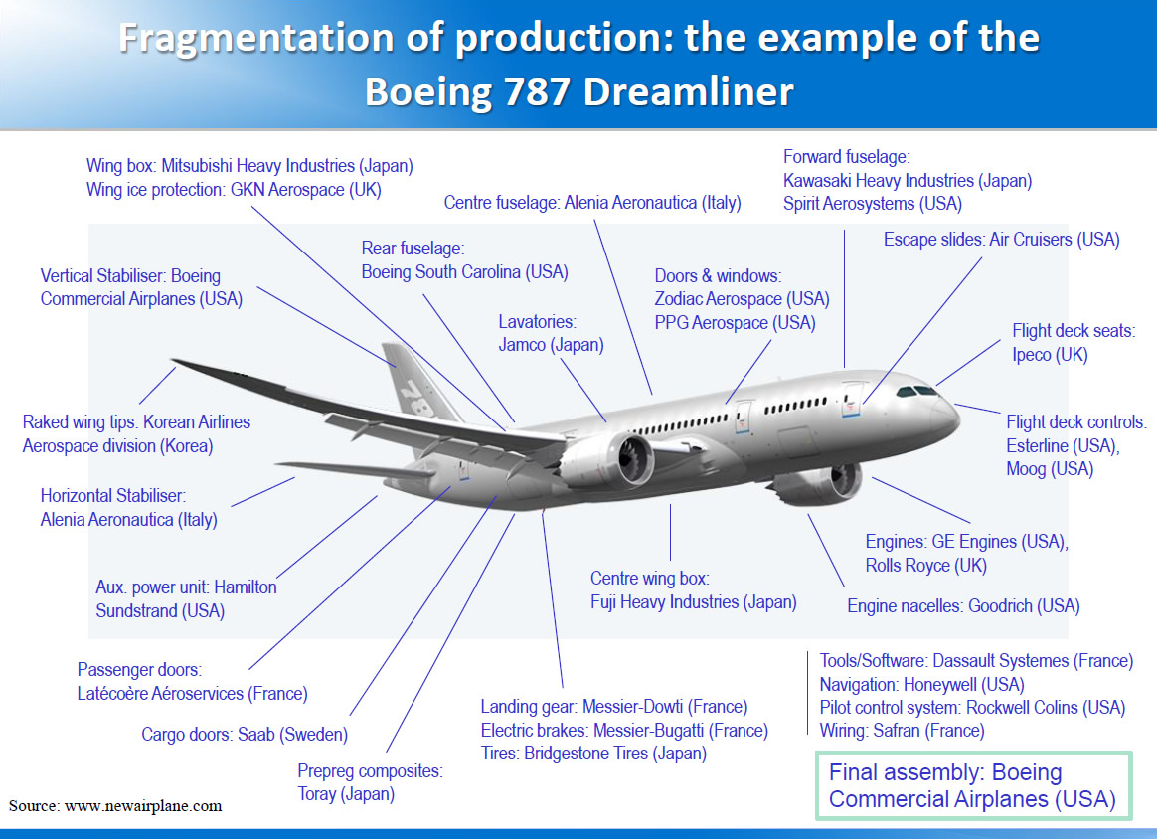

Slide 17
This is due to production fragmentation
Example: £500 iPad may involve £800 of trade
  Japan makes the £100 screen, exports it to China
  Korea makes the £200 chip, exports it China
  China assembles chip and screen, exports the £500 iPad to the US
World imports = China imports (£100+£200=£300) + US imports (£500) = £800
World GDP = £500 iPad

Slide 18
An overview of world trade
5 facts about world trade:
  1: Since 1960, world trade has become a much larger part of the world economy
  2: Almost 60% of trade is manufacturing goods
  3: International supply chains boost trade
  4: 90% of world trade is by sea

Slide 19
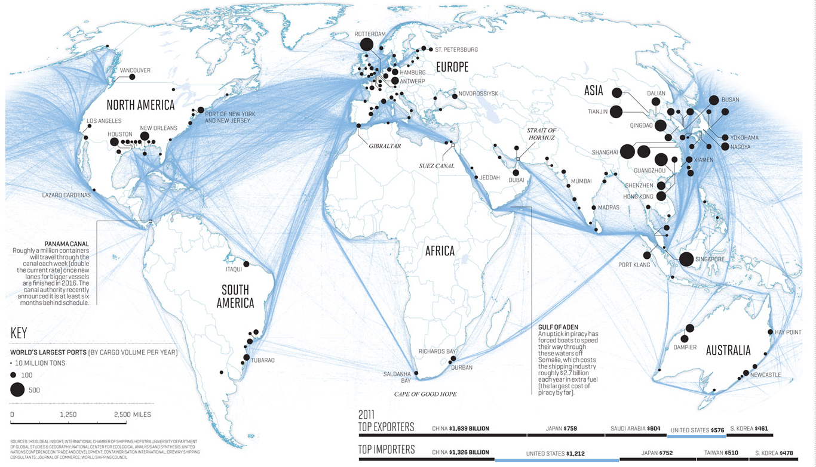
Notes:
Nicholas Rapp made this beautiful image of global shipping routes, highlighting the sinews of commerce in the modern age as global trade has boomed to unprecedented levels. Trade as a share of world output fell precipitously during the two world wars, and Cold War politics kept it relatively low for most of the second half of the twentieth century. But over the past generation it's boomed, thanks to a combination of changed policies and the invention of the container shipping. Something the map highlights is that the world economy features a couple of major shipping choke points — one around Malaysia and Singapore and the other around the Red Sea — where geopolitical instability could produce major disruptions to commerce. At the moment, a de facto American monopoly on ability to sustain far-flung naval operations prevents this from happening, and it wouldn't really be in anyone's interest to massively interrupt world trade, anyway. Then again, World War I wasn't really in anyone's interest either.

Slide 20
Notes:
Suez canal 1869

Slide 21
Notes:
Panama canal 1914

Slide 22

Notes:
Nicholas Rapp made this beautiful image of global shipping routes, highlighting the sinews of commerce in the modern age as global trade has boomed to unprecedented levels. Trade as a share of world output fell precipitously during the two world wars, and Cold War politics kept it relatively low for most of the second half of the twentieth century. But over the past generation it's boomed, thanks to a combination of changed policies and the invention of the container shipping. Something the map highlights is that the world economy features a couple of major shipping choke points — one around Malaysia and Singapore and the other around the Red Sea — where geopolitical instability could produce major disruptions to commerce. At the moment, a de facto American monopoly on ability to sustain far-flung naval operations prevents this from happening, and it wouldn't really be in anyone's interest to massively interrupt world trade, anyway. Then again, World War I wasn't really in anyone's interest either.

Slide 23
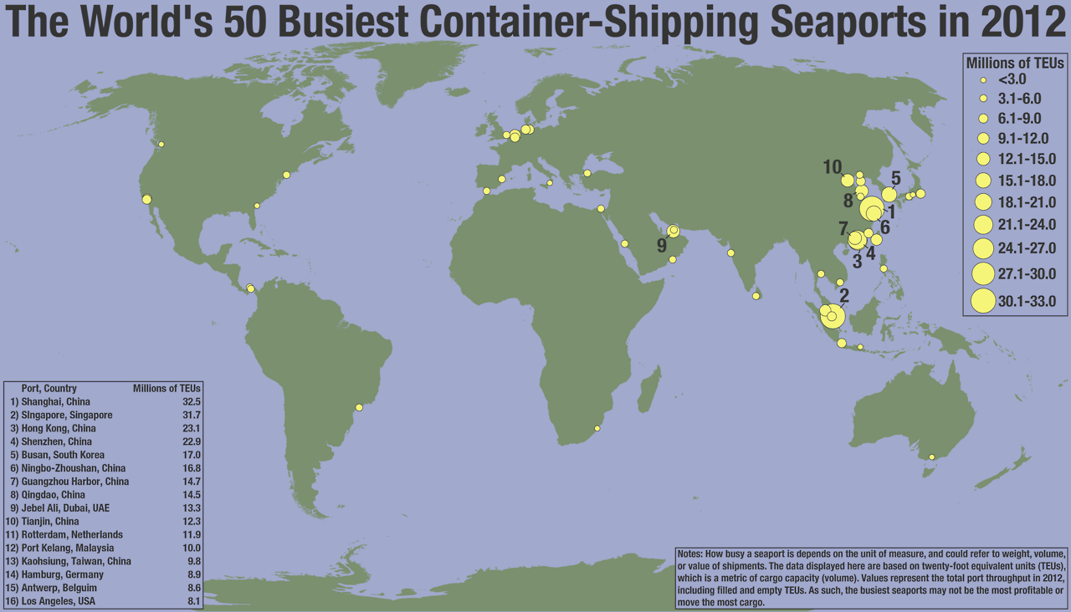
Notes:
Seaports are a physical manifestation of the global trade of goods. This Seth Kadish map shows the locations of the 50 busiest on the planet, and the size of the dots is scaled to the quantity of goods they handle. The heavy concentration of shipping activity on Asia's Pacific Coast is a striking symbol of both East Asia's enormous population and its outsized role in the global manufacturing sector. India and Africa, meanwhile, are visibly suffering from a chicken and egg problem of underdevelopment. They lack the kind of factory growth that would provide economic opporunities for their people and justify the creation of busy ports. At the same time, they lack the kind of infrastructure — including high quality container ports — that would support rapid growth of manufacturing.

Slide 24
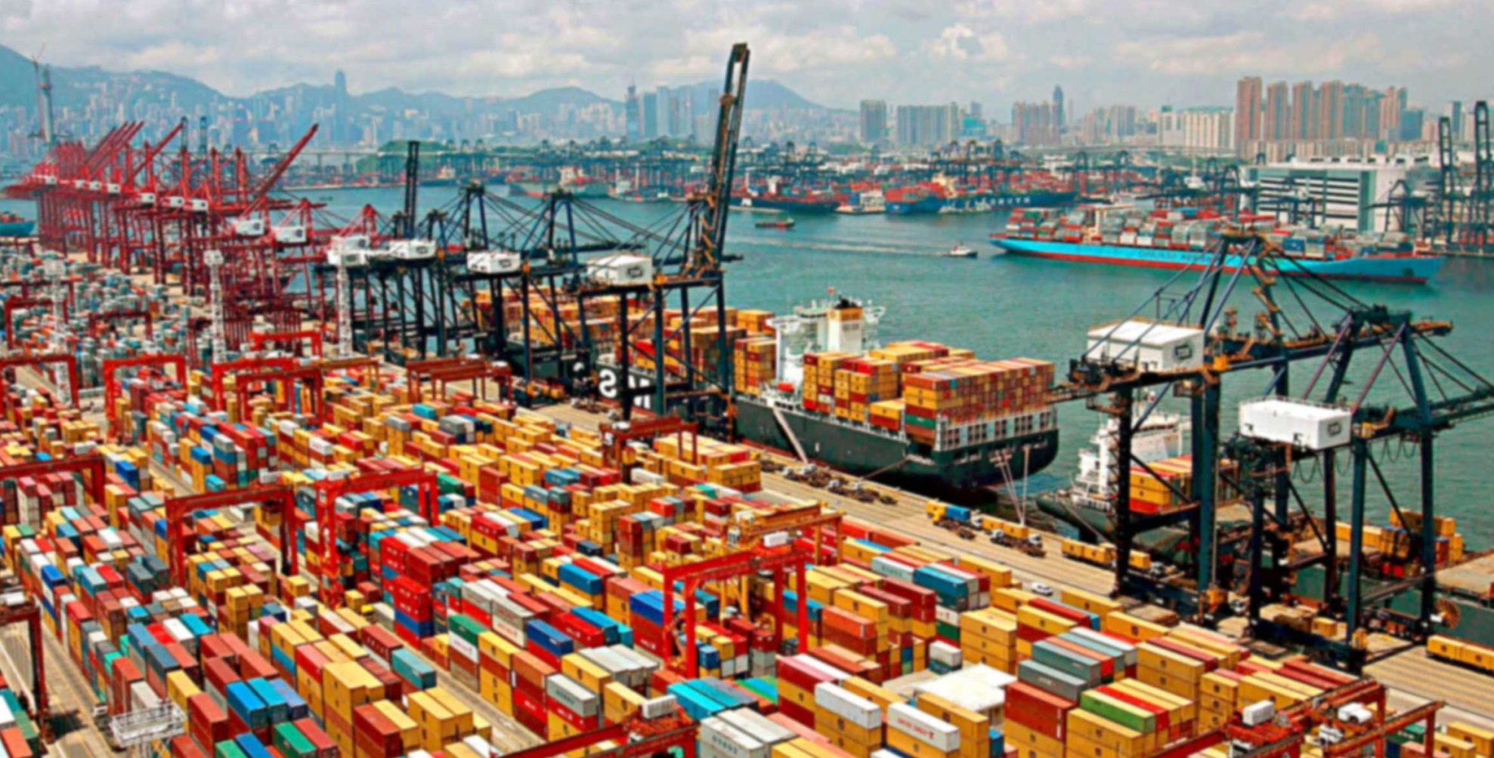
Notes:
Shanghai

Slide 25
An overview of world trade
5 facts about world trade:
  1: Since 1960, world trade has become a much larger part of the world economy
  2: Almost 60% of trade is manufacturing goods
  3: International supply chains boost trade
  4: 90% of world trade is by sea
  5: Technology has greatly reduced trade costs

Slide 26
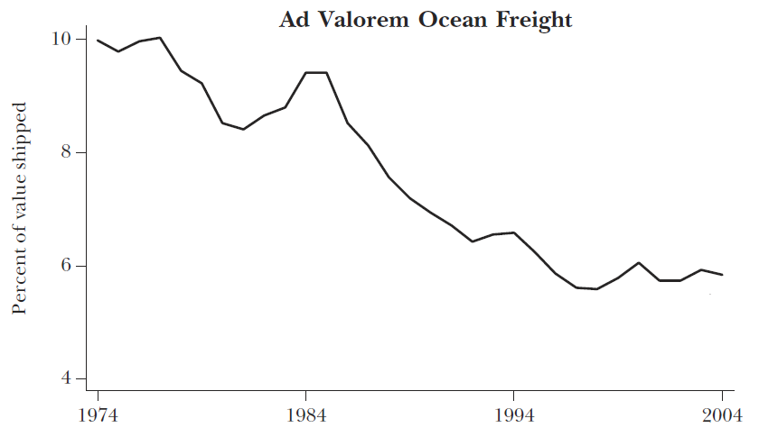

Slide 27
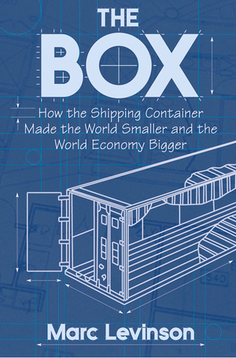
"One of the most significant, yet least noticed, economic developments of the last few decades… Containerization slashed the cost of transporting goods around the world and made the boom in global trade possible”

Slide 28
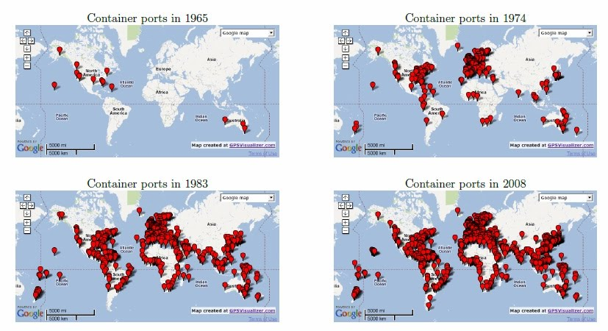

Slide 29
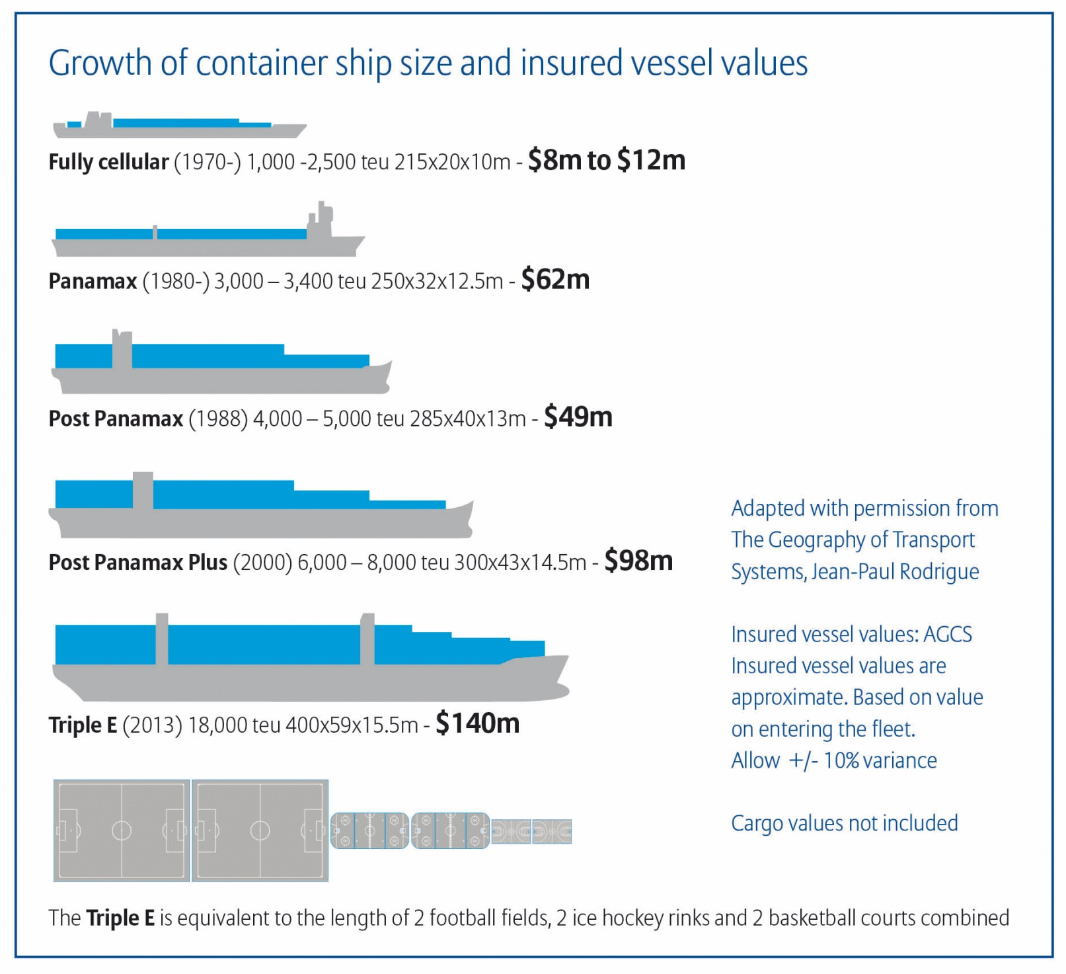

Slide 30
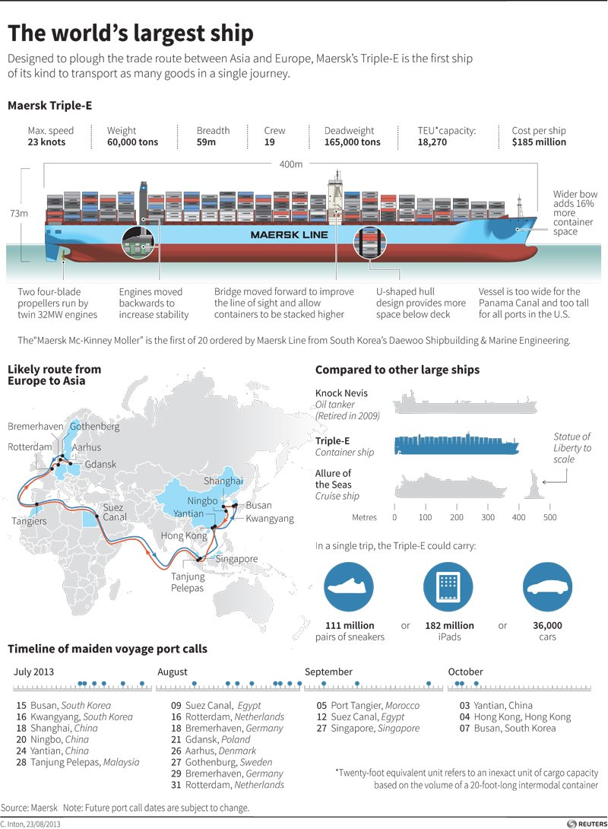

Slide 31
An overview of world trade
5 facts about world trade:
  1: Since 1960, world trade has become a much larger part of the world economy
  2: Almost 60% of trade is manufacturing goods
  3: International supply chains boost trade
  4: 90% of world trade is by sea
  5: Technology has greatly reduced trade costs

Slide 32
Week 1
An overview of world trade
Who trades with whom? The gravity model

Slide 33
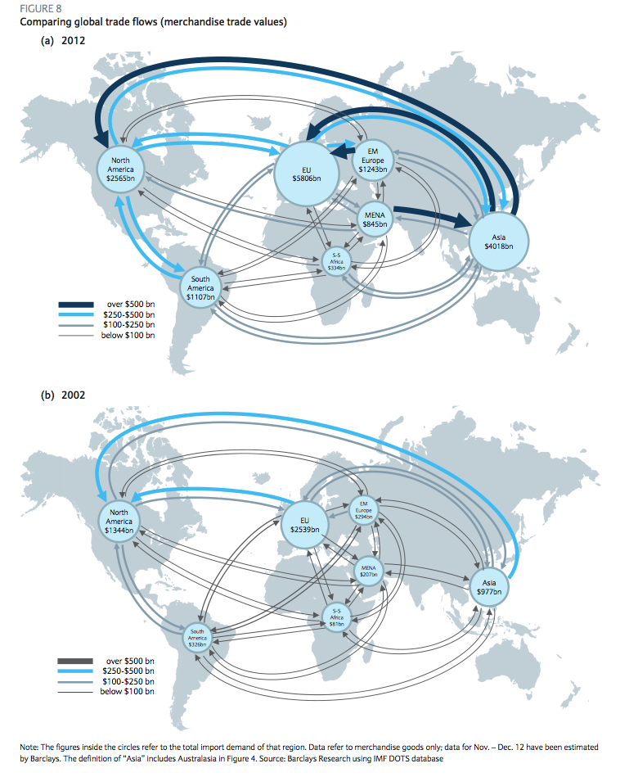
The gravity model

Slide 34
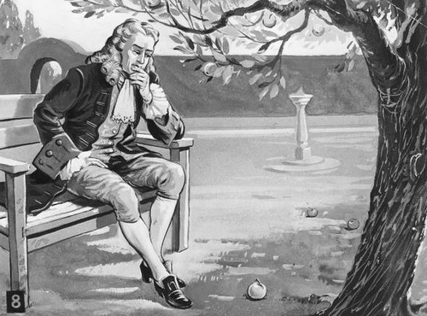
The gravity model

Slide 35
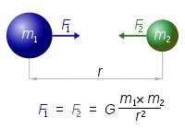
The gravity model
Newton’s Law: Any two bodies in the universe attract each other with a force that is directly proportional to the product of their masses and inversely proportional to the square of the distance between them.

Slide 36
The gravity model
The gravity model also explains international trade!
Size (GDP) and distance determine bilateral trade across countries

Slide 37

The gravity model
X_{ni} are exports from n to i
Y_{i} and Y_{n} are exporter and importer GDPs
D_{ni} is distance from i to n
G is a constant
In most estimations a ≈ b ≈ c ≈ 1

Slide 38
“The gravity model”
Gravity Law: Holding constant the product of two countries’ sizes, their bilateral trade will, on average, be inversely proportional to the distance between them.

Slide 39
The gravity model
Gravity models have produced some of the clearest and most robust findings in economics

Slide 40
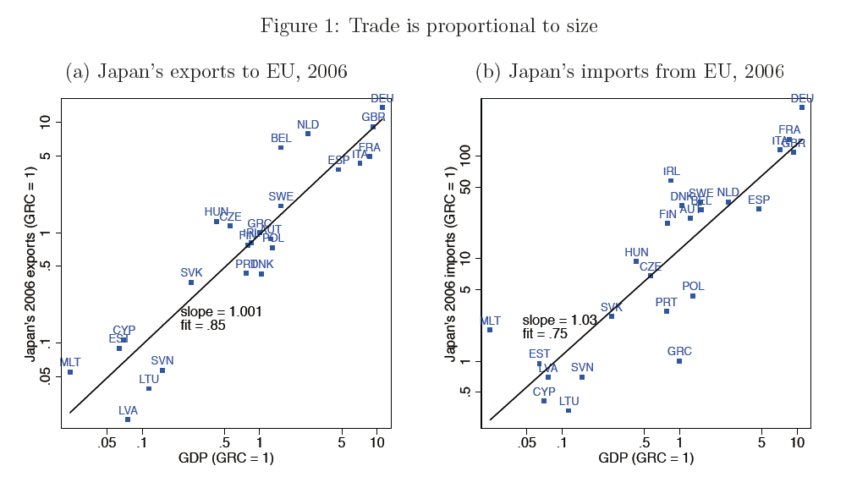
The gravity model

Slide 41
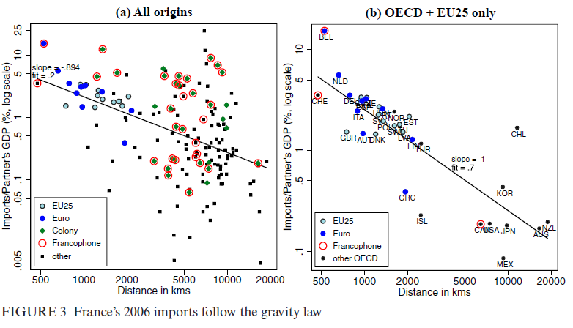
The gravity model

Slide 42
The gravity model

Slide 43
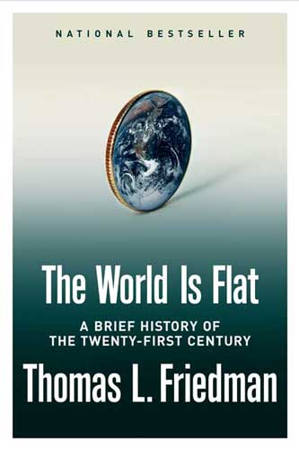

The gravity model
Has globalization brought the death of distance?
Notes:
It can also be used to estimate the impact of various trade barriers on trade such as language and cultural barriers, legal barriers, and the impact of trade agreements
George Orwell (1944): Reading a batch of rather shallowly optimistic ‘progressive’ books, I was struck by the automatic way in which people go on repeating certain phrases which were fashionable before 1914. Two great favourites are ‘the abolition of distance’ and ‘the disappearance of frontiers.’

Slide 44
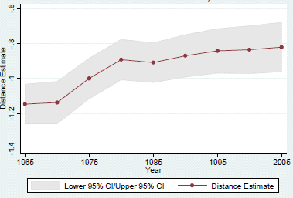
The gravity model

Slide 45
Week 1
An overview of world trade
Who trades with whom? The gravity model
The border effect

Slide 46
The border effect
Trade between countries is harder than trade between regions within a country
Economists have coined how harder it is “the border effect”, as it involves crossing an international border
The border effect is the empirical regularity that trade is much higher within countries than across country borders

Slide 47
The border effect
Example:
  Do US States and Canadian provinces trade as much between them when goods have to cross the border?
  We can answer this question by looking at how much Canadian provinces and US States at similar distances trade with British Columbia

Slide 48
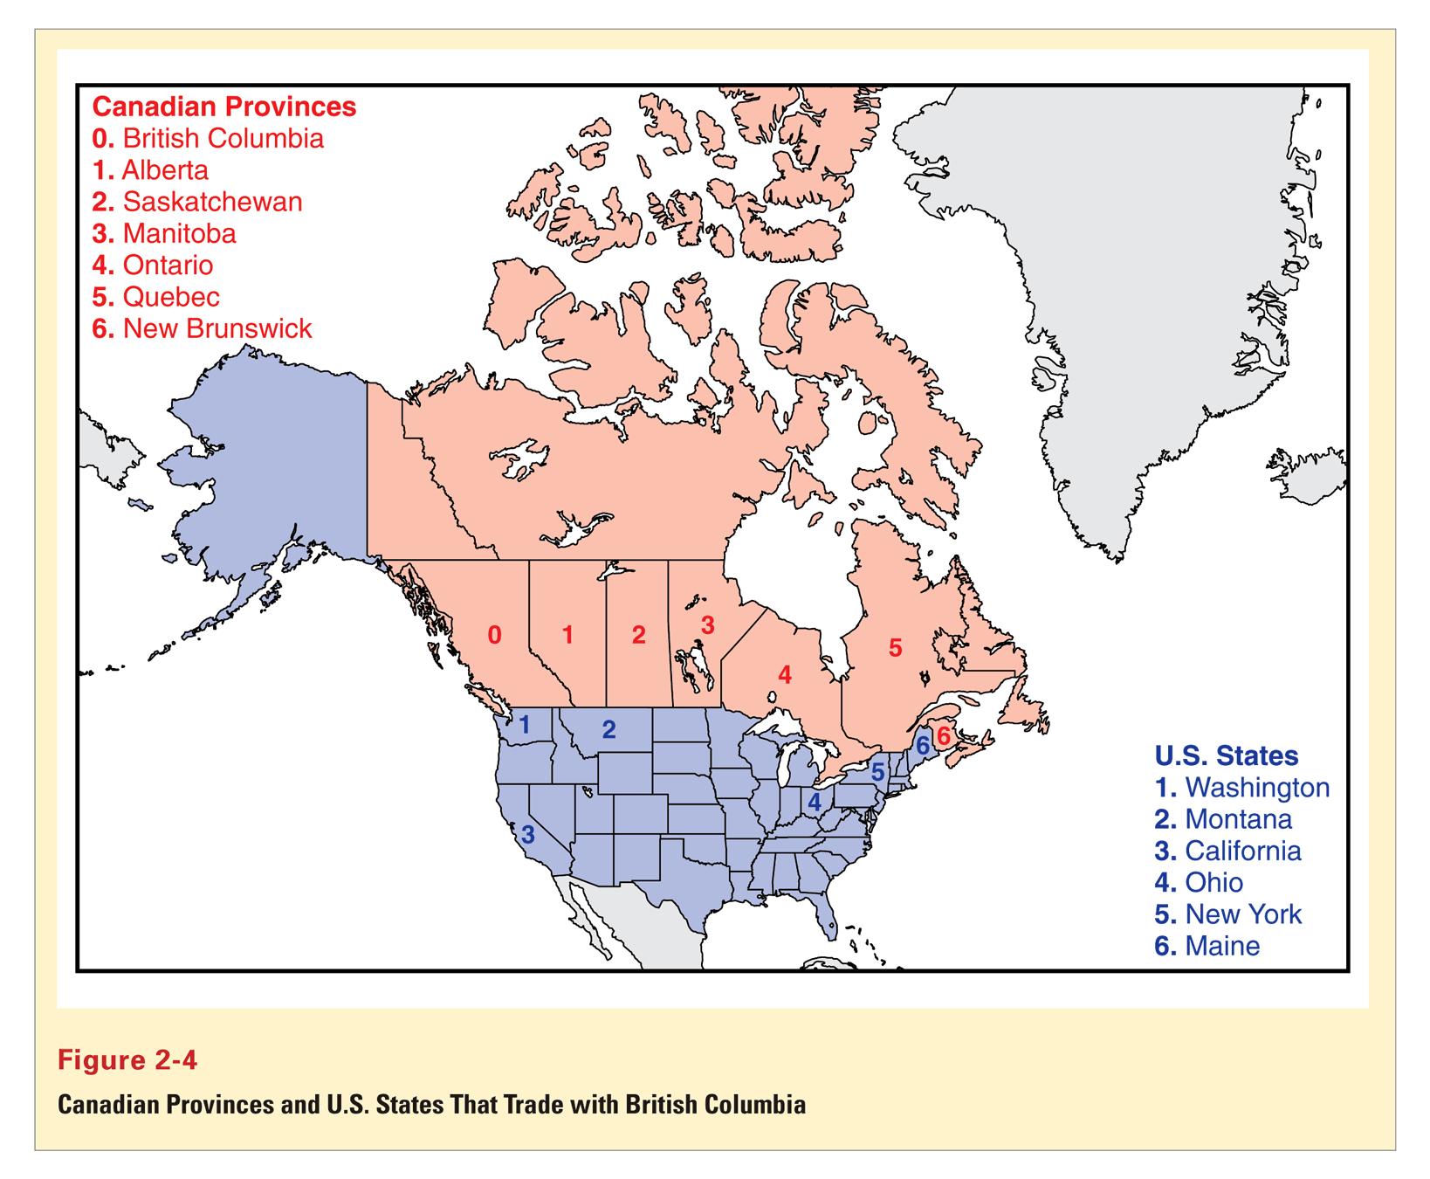

Slide 49
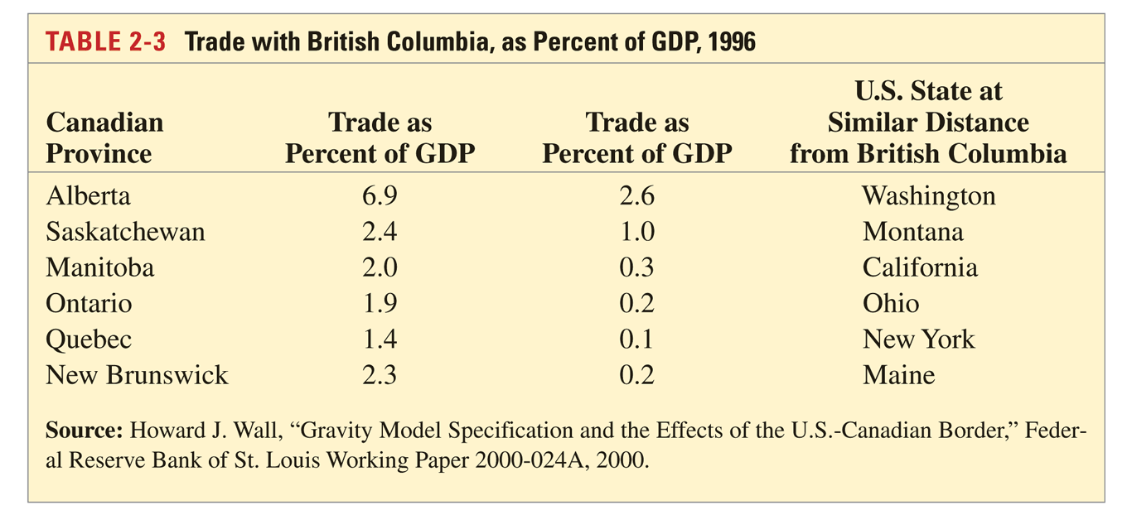
The border effect
Crossing the border reduces trade by 80%

Slide 50
The border effect
Why do borders reduce trade?
  Tariffs
  Administrative barriers (docs)
  Currency exchange
  Cultural barriers
  …?
The border effect can also be thought of as a home bias, i.e. a preference for home goods over foreign ones

Slide 51
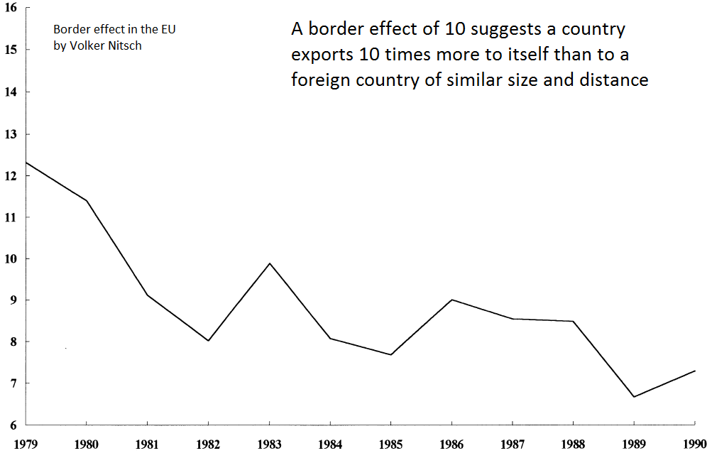

Slide 52
Extra readings
Head, K. and Mayer, T. (2013), What separates us? Sources of resistance to globalization. Canadian Journal of Economics, 46: 1196–1231.

